Slide 1
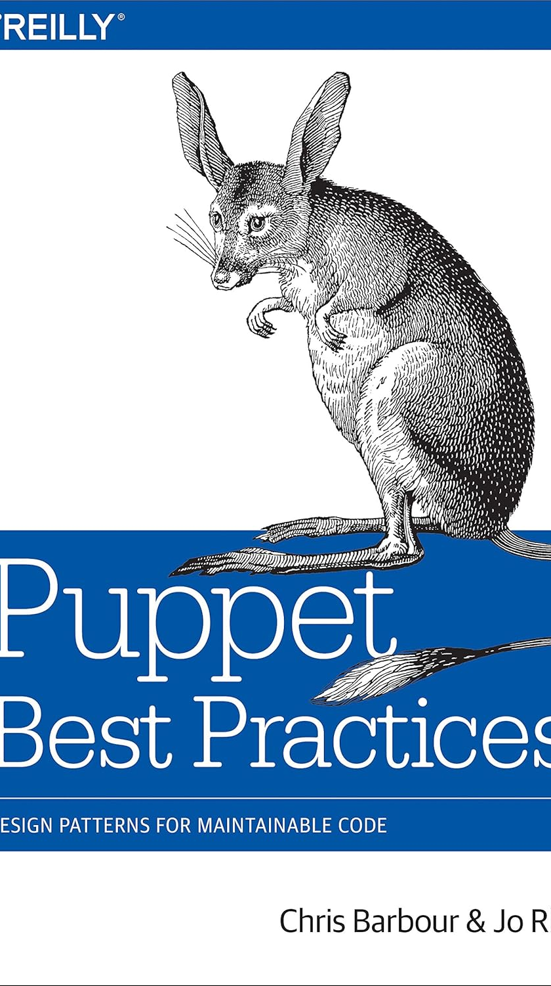
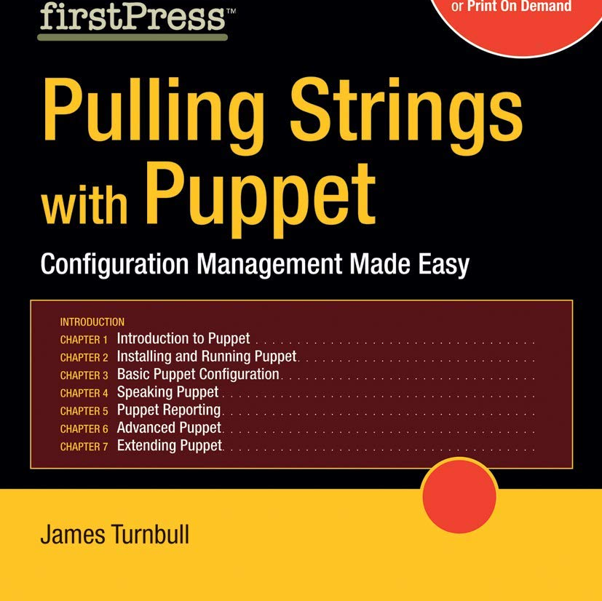
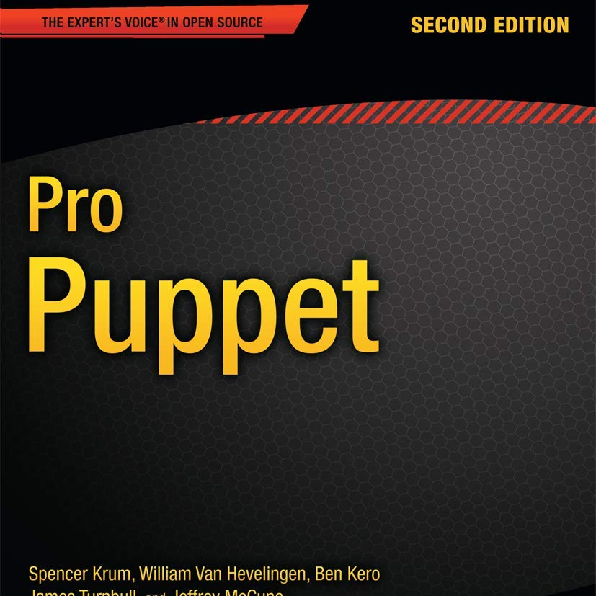
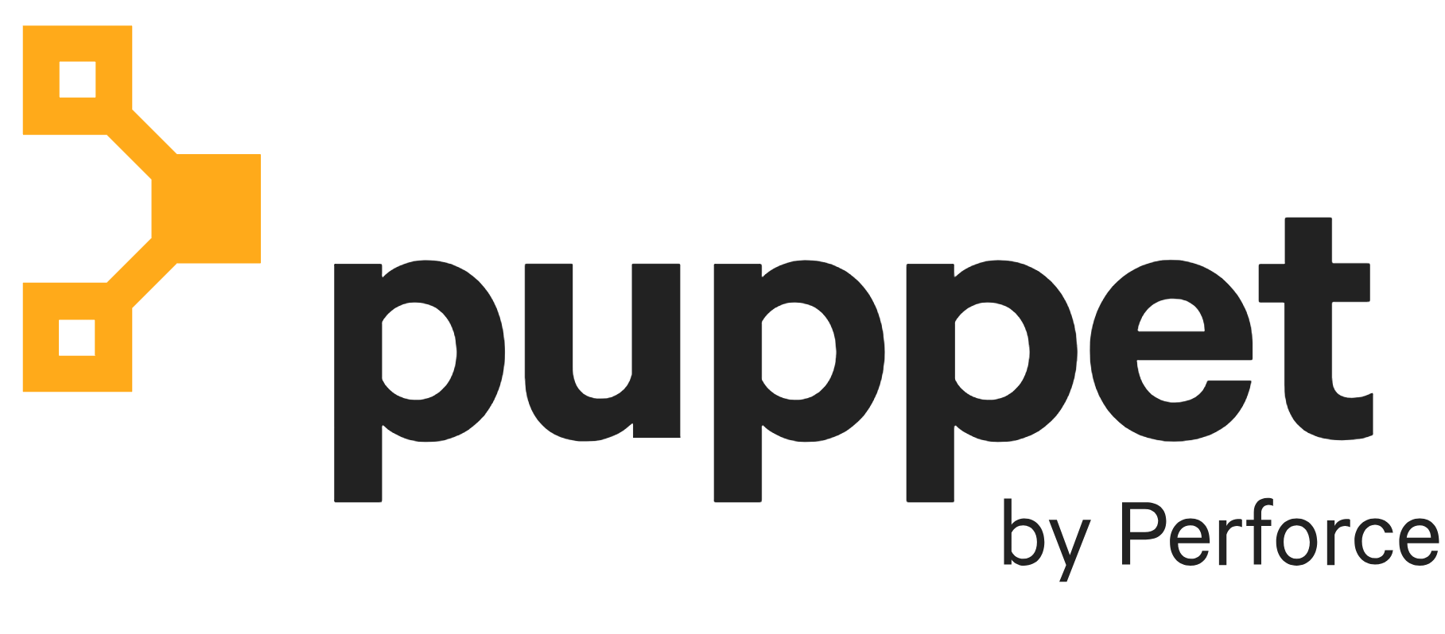
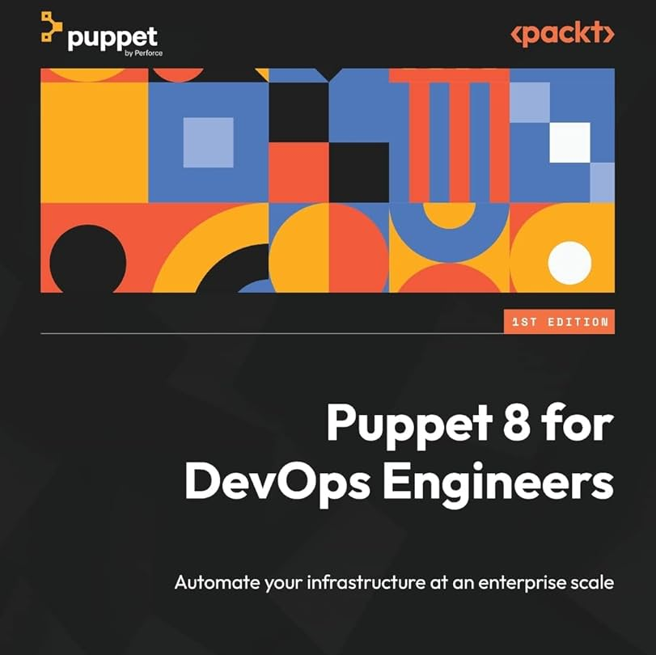
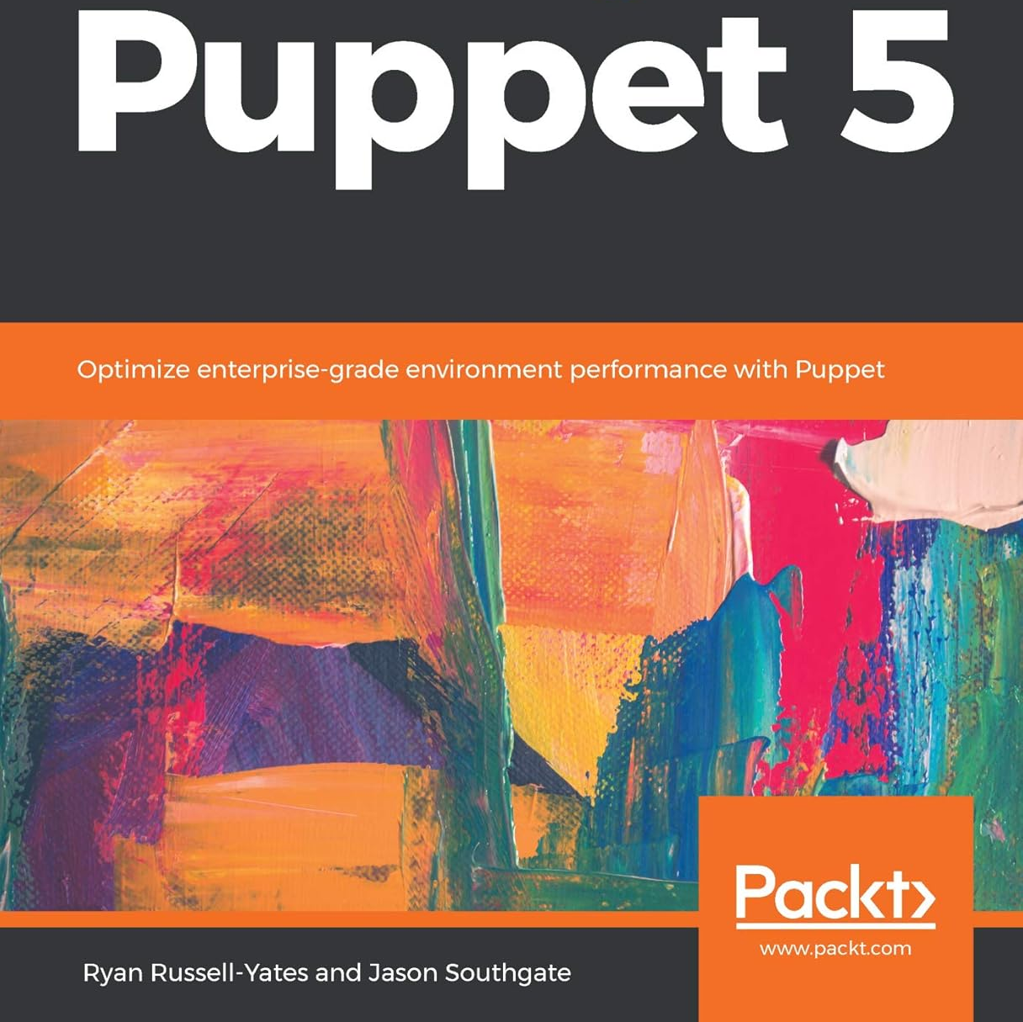
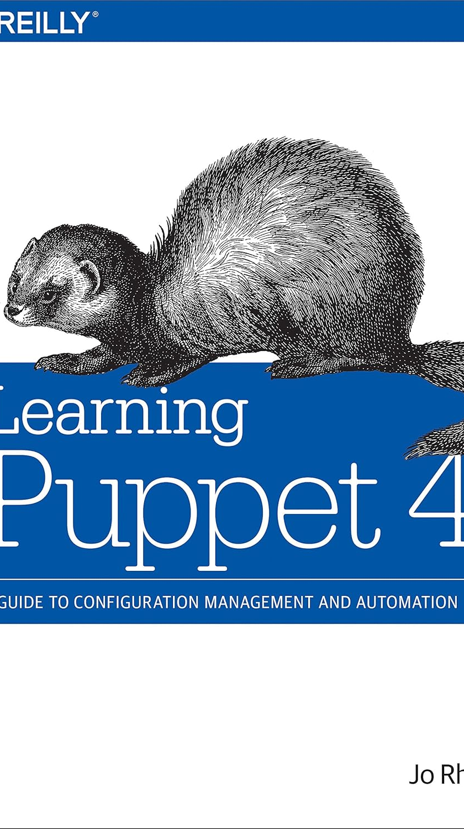
Puppet Evolution Key Changes and Modernisation Tips
David Sandilands
Puppet Community and Developer Relationship Lead
February 2025

Slide 2
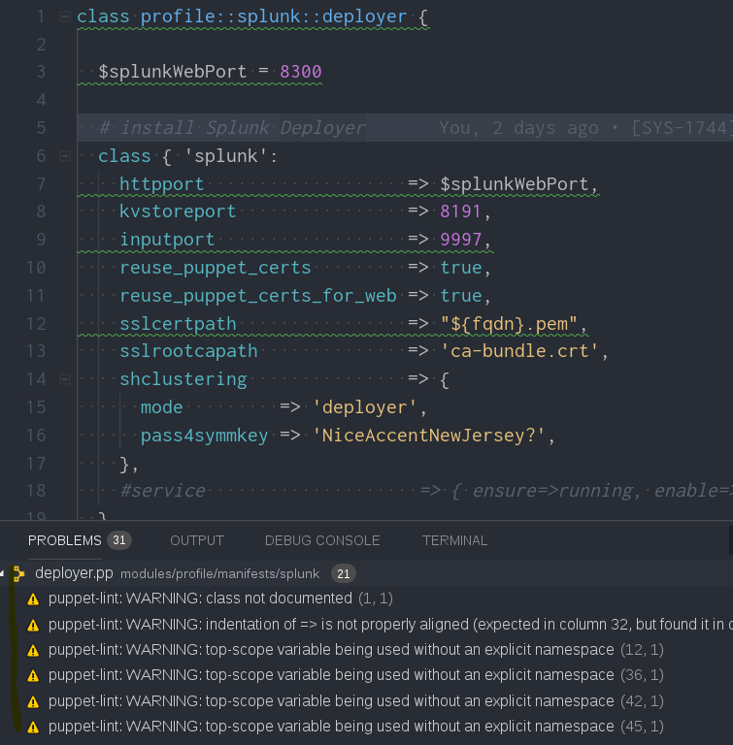
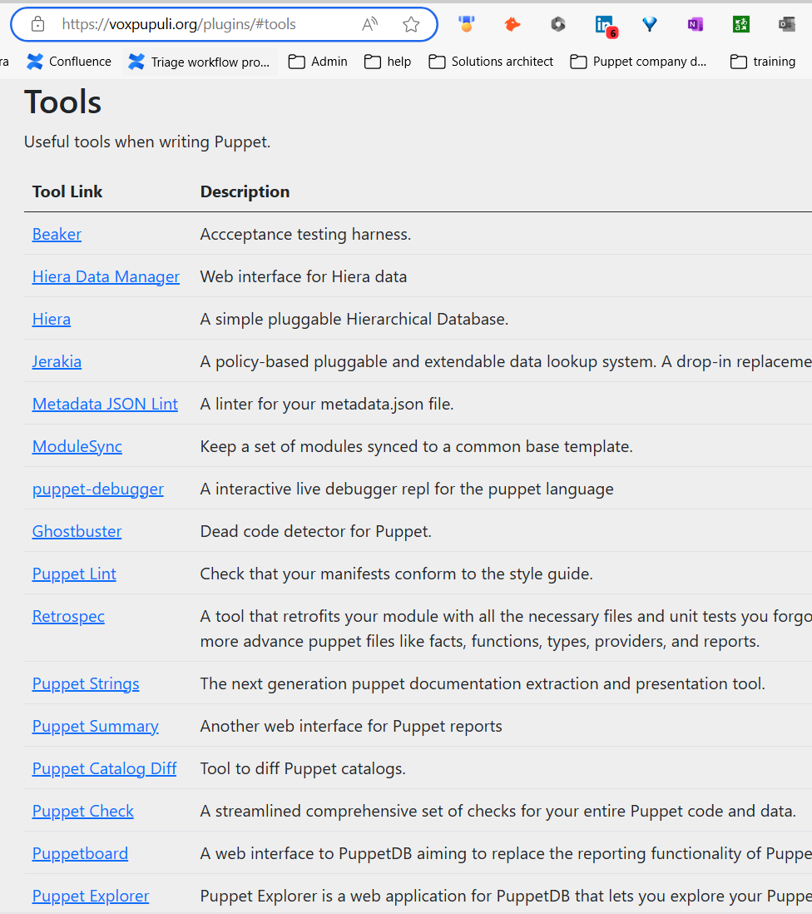
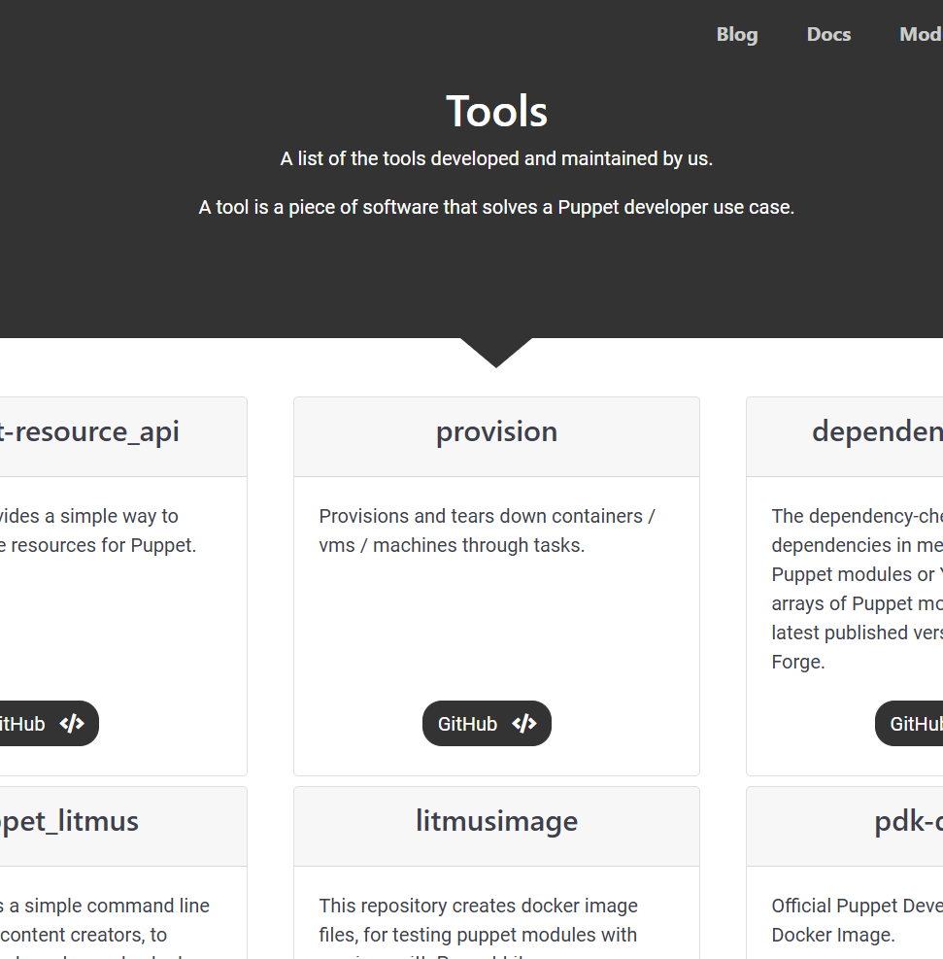
Use the Right Tools
Puppet Development Kit (PDK)
Puppet VS Code extension
Dev tools and approaches from Vox Pupuli
AI like GitHub CoPilot (responsibly)

Slide 3
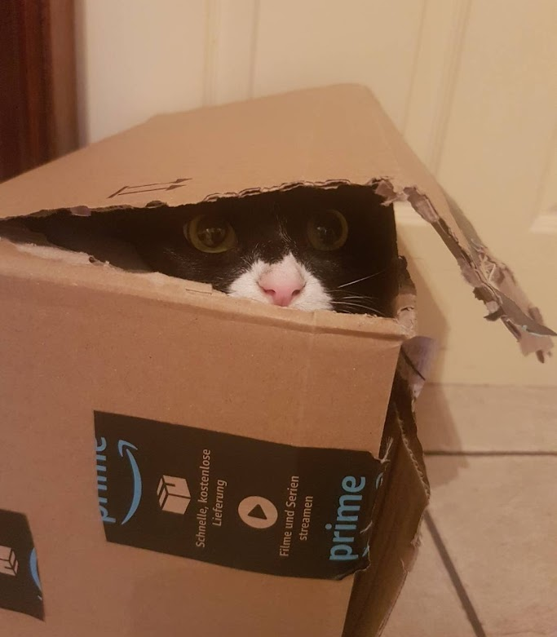
Packages
In 0.x versions of Puppet, some users found having too many package resources slowed everything down.
So they created repos where a profile could install a single package and pull all dependencies down.

Slide 4
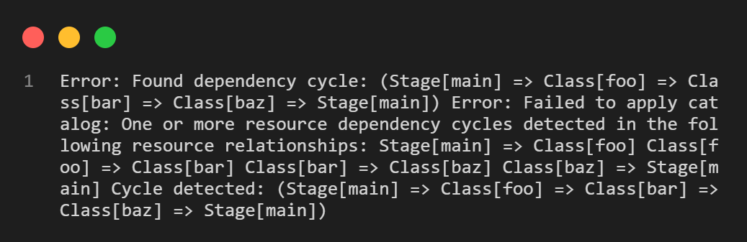
Stages
DON’T
Just DON’T
Typical early setups, replicating the flow of scripts.
Makes maintenance and expansion hard.

Slide 5
site.pp and Module Defaults
Do not use style defaults outside of site.pp
Legacy style defaults "should occur only at the top scope in your site manifest … because resource defaults propagate through dynamic scope, which can have unpredictable effects far away from where the default was declared."
site.pp can create confusion

Slide 6
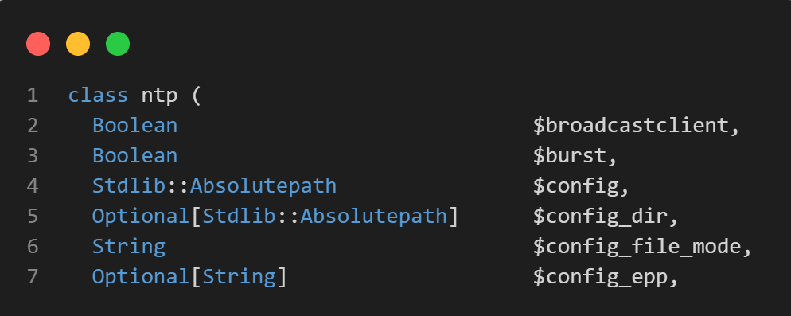
Data Types
Introduced during Puppet 4 2015, default to strict in Puppet 8 2023
Validation and security
AI can be pretty good at putting in data types
Don’t forget an APL returning undef will error on Puppet 8

Slide 7
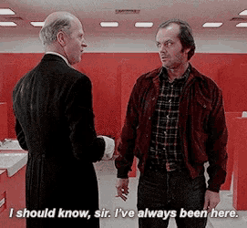
Overuse of Templates and Content
file_line was introduced in stdlib 2.1 in 2014 around about Puppet 3
Before that, people used content/templates — or you battled with Augeas
A lot of things were just left hardcoded or unmanaged

Slide 8
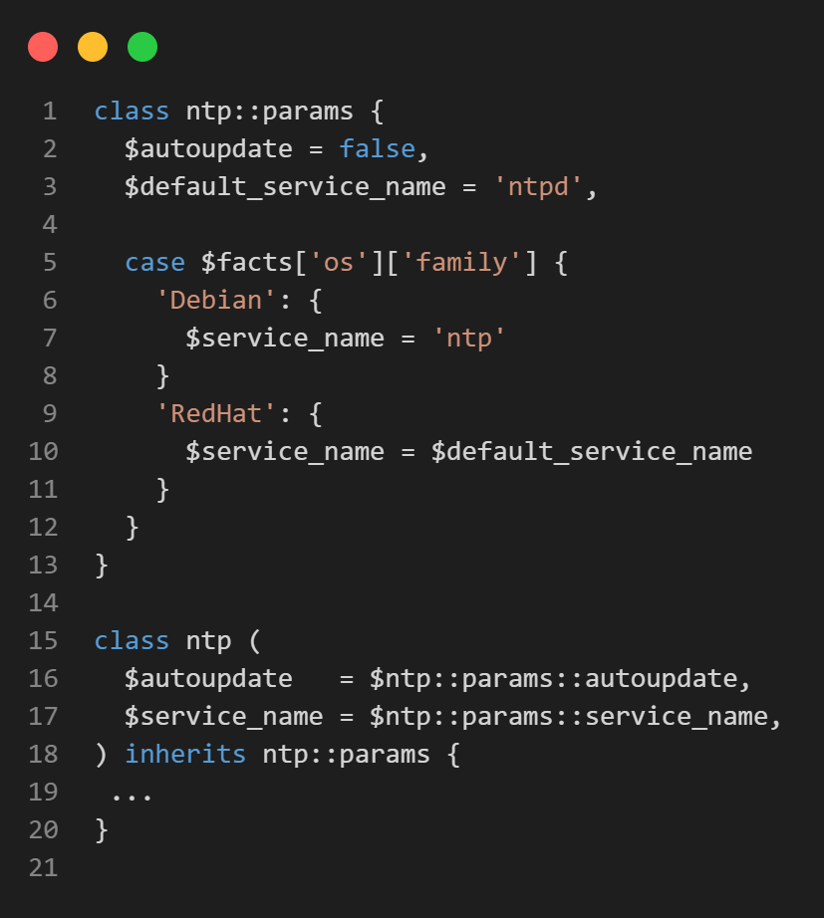
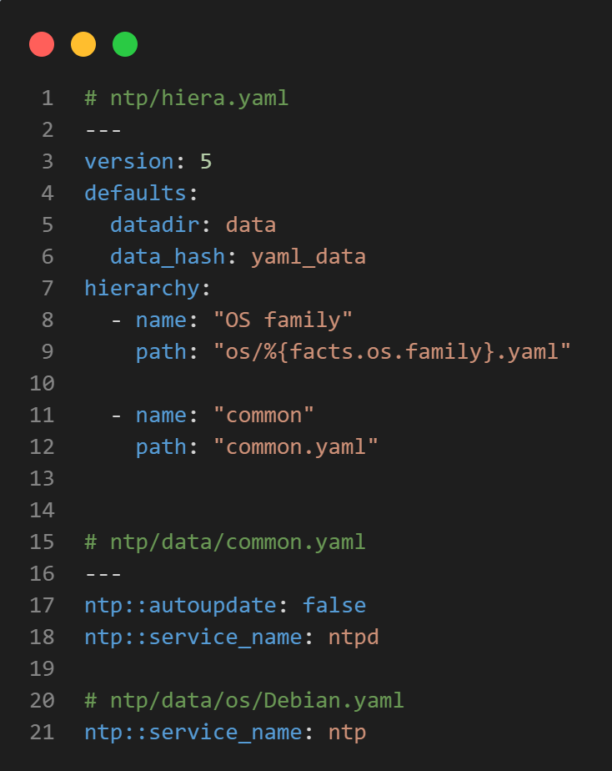
params.pp
Before we got to Hiera 5 in 2016 with Puppet 5
With hiera, we can simplify:
No inherit from another class
No need to use = operator
No case/ifs

Slide 9
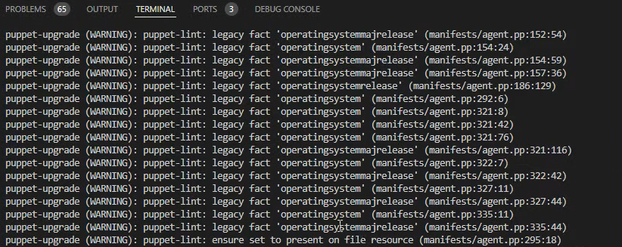
Facts
Legacy facts were introduced in 2014 with the inclusion of Facter 2 in Puppet 3.2
Finally removed (by default) in Puppet 8
Use the facts['networking']['hostname’] instead of top scoped variables

Slide 10
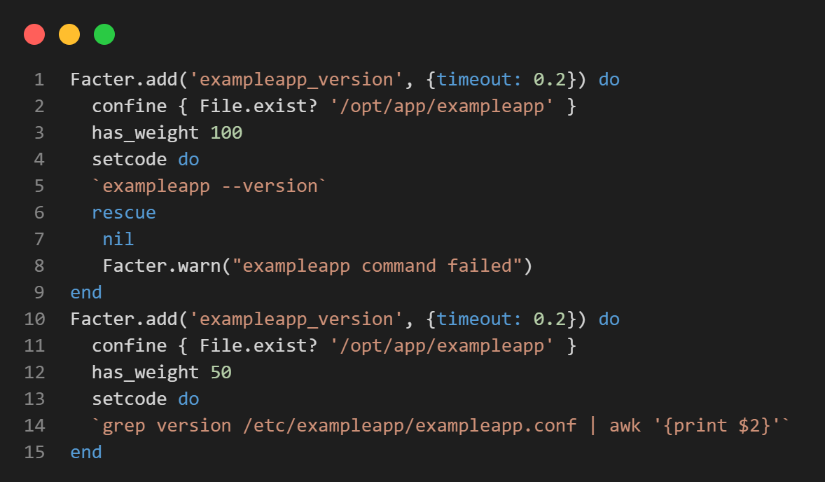
Use the Full Features of Custom Facts
Most people right as simple script and leave it
Timeouts
Weighted resolutions
Confine and features
Rescue blocks

Slide 11
Core Types Removed
In Puppet 6 (2018), a number of core types were moved to modules. Make sure you add to Puppetfile and fixtures
augeas
cron
host
mount
scheduled_task
selboolean
selmodule
ssh_authorized_key
sshkey
yumrepo
zfs
zone
zpool

Slide 12
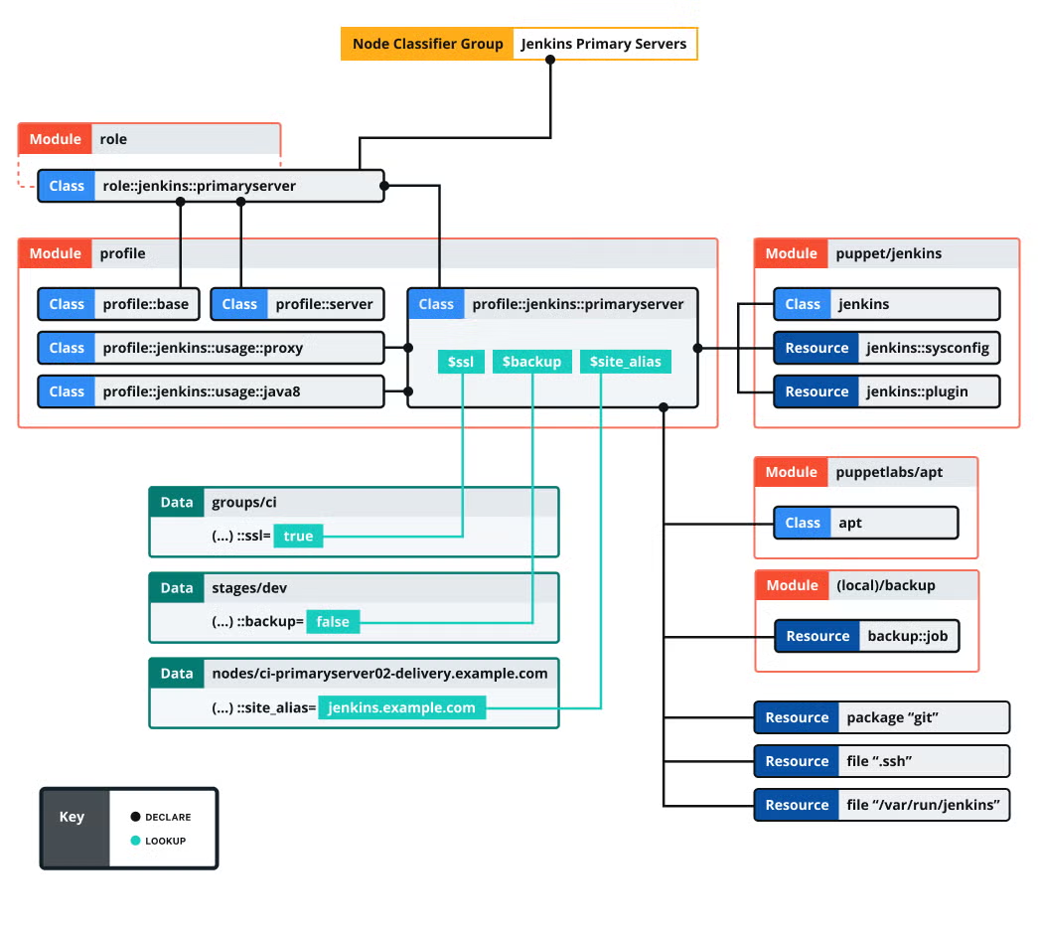
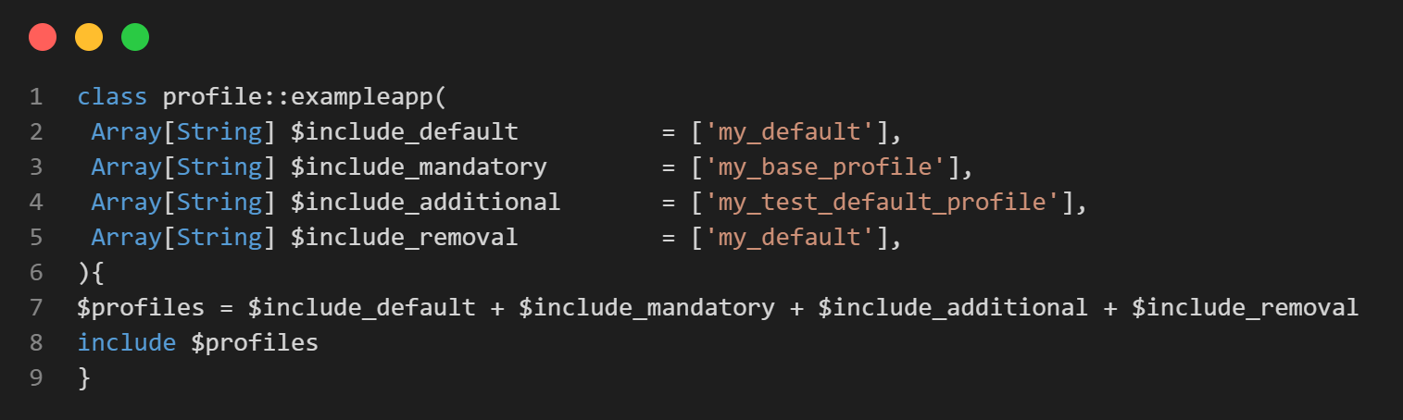
Roles and Profiles
Way back in 2014, Gary Larizza first talked about roles and profiles
Gary always highlighted the idea that patterns weren’t supposed to be followed religiously

Slide 13
Move from ERB to ERP Templates
EPP v ERB
EPP is faster (due to only scoping facts needed)
EPP provides greater security as it has a limited scope and validates all data
ERB does not validate and drops non-existent variables
EPP comes with render and validate tools
EPP can process Sensitive without unwrapping
Watch out for voxpupuli/erb2epp

Slide 14
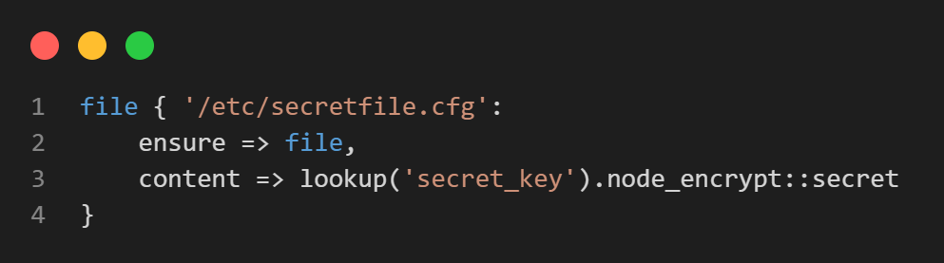
Sensitive Data
Keep your data secure throughout
EPP Use hiera-eyaml at rest in hiera
Use Sensitive data in the catalog
Use node_encrypt for transport

Slide 15
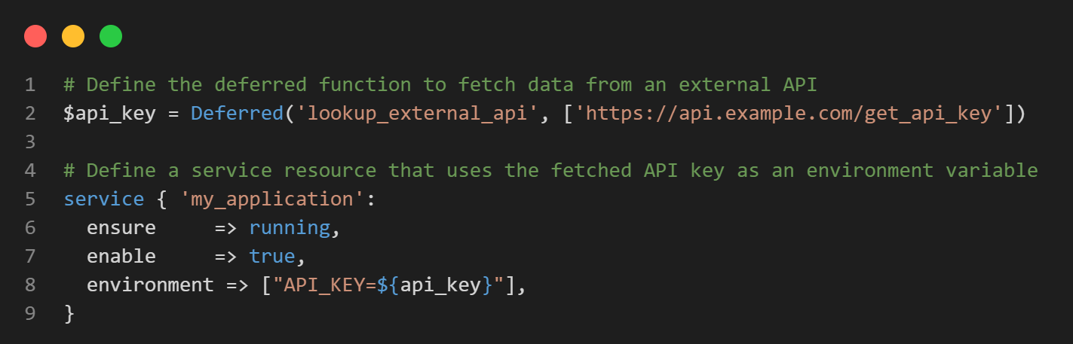
Sensitive Templates and Deferred Functions
Puppet 6.20 and later can evaluate Sensitive instead of having to unwrap in the template
As of Puppet 7.17 / 8, deferred functions are lazily evaluated

Slide 16
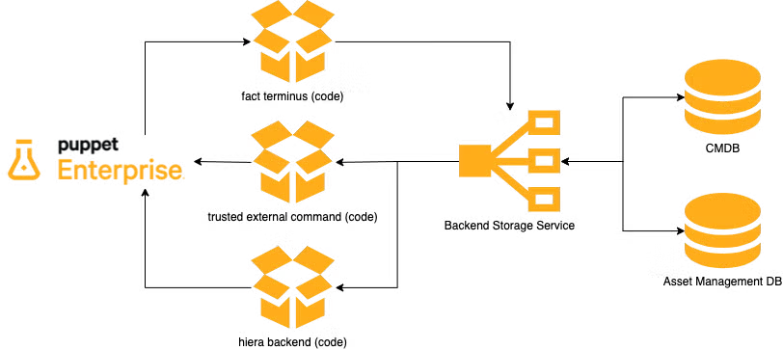
Trusted Facts and Commands
Introduced in Puppet 6.11 (2021) to access external data or make hiera and classification flexible
Check out puppetlabs/puppet-data-service on GitHub
Puppet Docs: Integration with External Data Providers

Slide 17
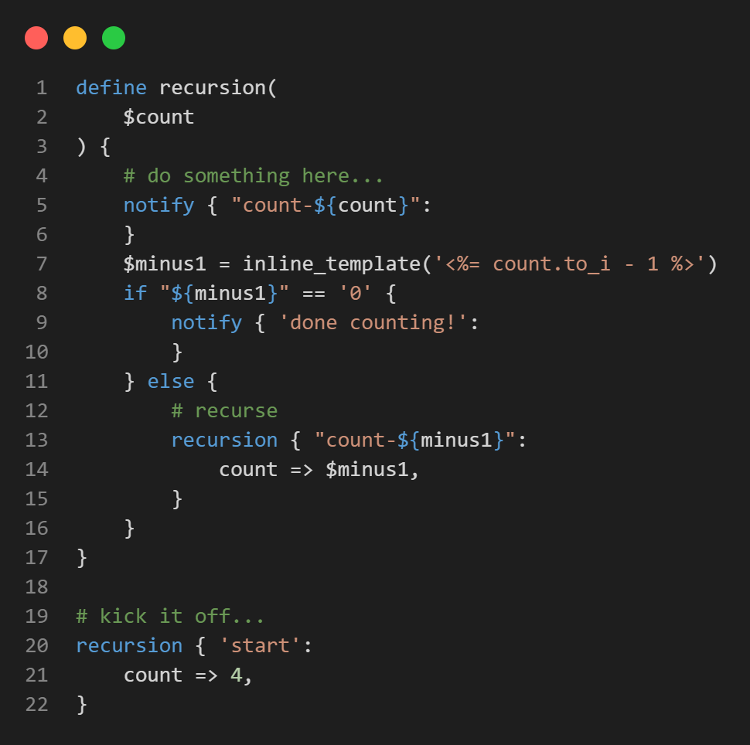
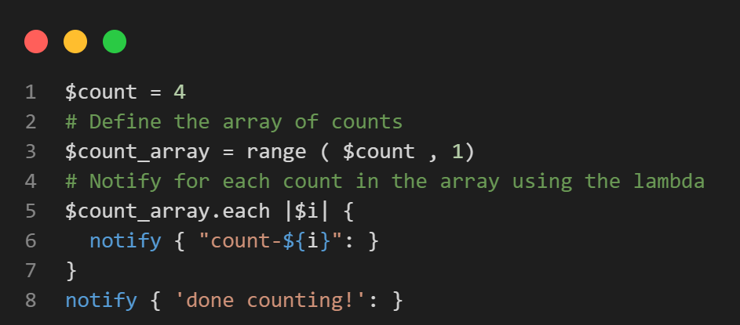
Lambdas
Inline templates or defined types were common before Puppet 4
17 functions create confusion
Just look at the most common
each 2799
map 425
filter 233
reduce 141
unique 168

Slide 18
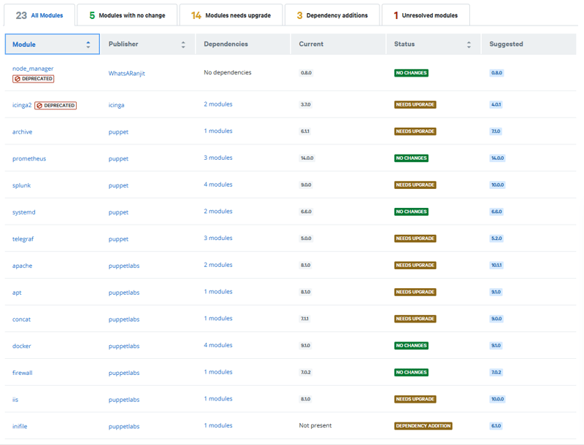
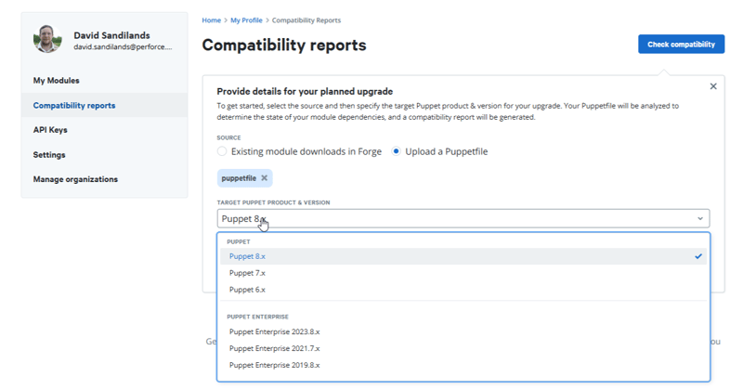
Outdated Modules
Use the Forge Compatibility Report to check for outdated modules
Subscribe to individual modules to get notified when there's an update

Slide 19
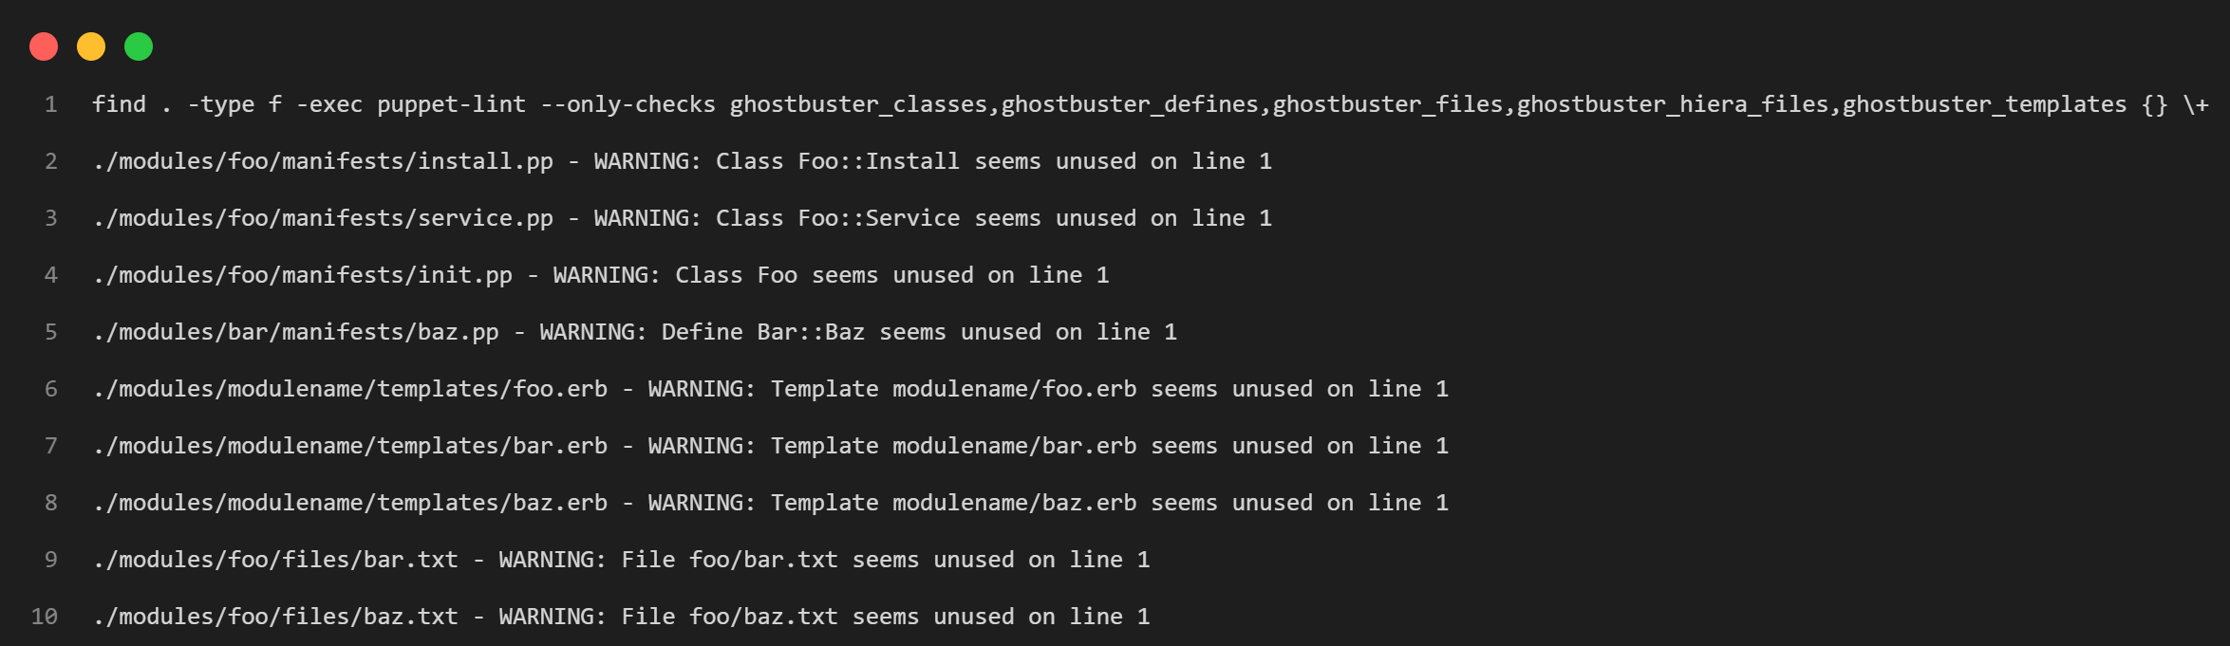
Get Rid of Unused Code and Modules
voxpupuli/puppet-ghostbuster on GitHub

Slide 20
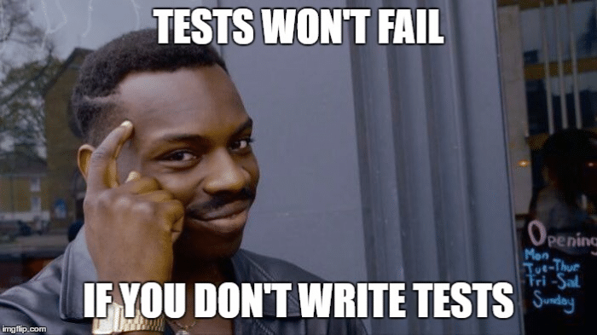
Testing and Debugging
At least add a compile test, PDK --add-tests
Enforce coverage completion
Use Onceover
Use AI responsibly

