Slide 1
Bolt Makes it Easy to Use Puppet
Gavin Didrichsen, Principal Software Engineer Puppet by Perforce

Slide 4
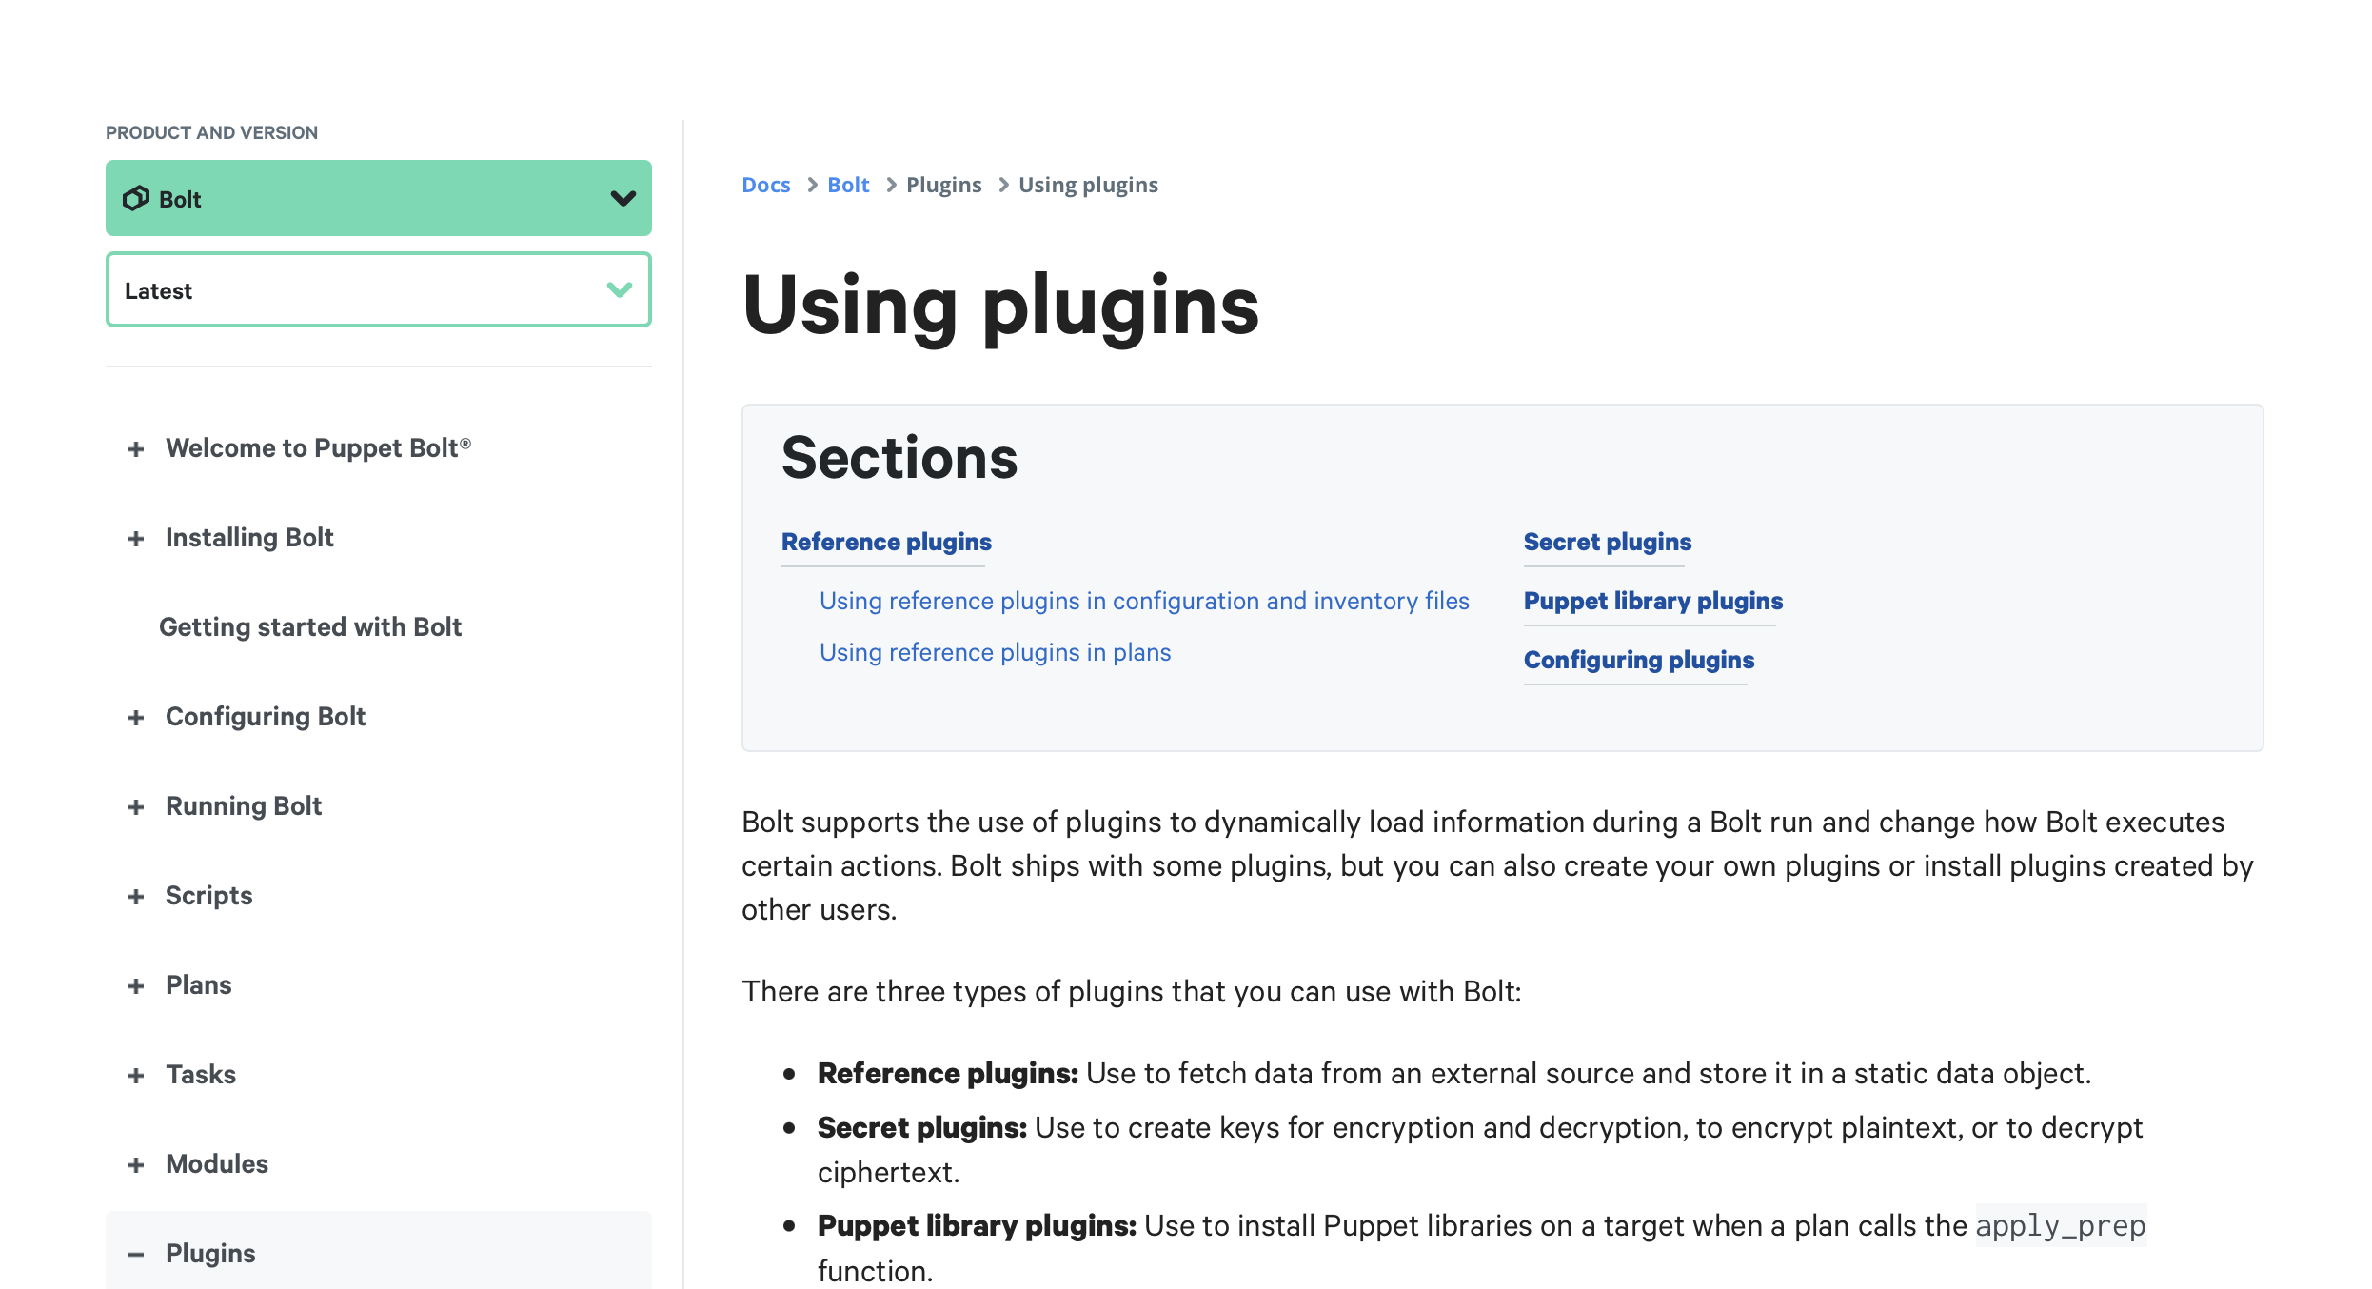
What is a bolt plugin?
<https://www.puppet.com/docs/bolt/latest/using_plugins>
4

Slide 5
DEMO: How use the orbstack_bolt_inventory gem?
Key points
`orby` => orbstack inventory.yaml
`orby –g "GROUP1:REGEX1,GROUP2:REGEX2"`
5

Slide 6
DEMO: How to setup a basic inventory plugin?
Keypoints: 5 files
bolt-project.yaml
inventory.yaml
modules/basic_plugin/bolt-plugin.json
modules/basic_plugin/tasks/resolve_reference.json
modules/basic_plugin/tasks/resolve_reference.rb
6

Slide 7
DEMO: How use orbstack_bolt_inventory as a bolt plugin?
Kdypoints
keypoints
7

Slide 8
Thank You for Listening!
QUESTIONS?
8

