Slide 1
Customising Reporting with Puppet Report Processor
David Sandilands
Community and Developer Relations Lead
Brónach Falls, Software Engineer
Puppet by Perforce

Slide 2
What is a Report Processor?
The report processor in Puppet is a component that transforms the output of Puppet run reports.
It enables administrators to process these reports according to specific requirements, such as storing, analysing, or alerting based on the events and statuses contained within them.
Purpose
Data Handling: Automates the management of report data, making it easier to store, access, and analyse.​
Integration: Seamlessly integrates with external tools and systems, such as monitoring solutions or data analytics platforms.​
Notification: Facilitates real-time notifications and alerts based on the report outcomes, enhancing proactive management of infrastructure.​

Slide 4
Placement of a Custom Report Processor

Slide 7
Structure of a Custom Report Processor

Slide 14
Deploy

Slide 15
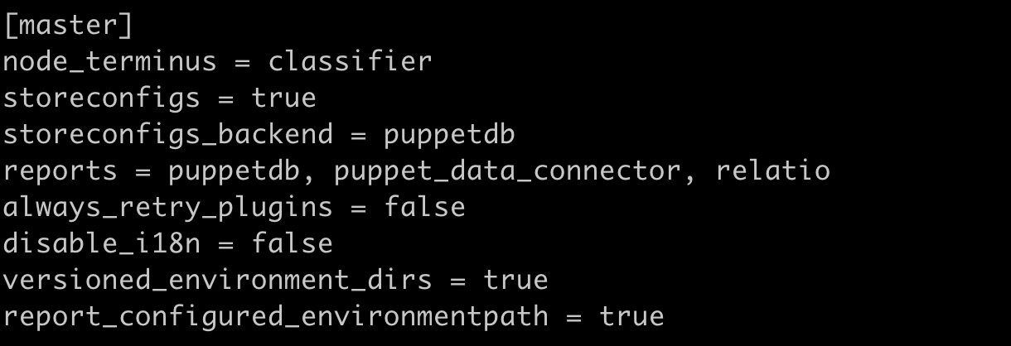
Set Up the puppet.conf

Slide 16
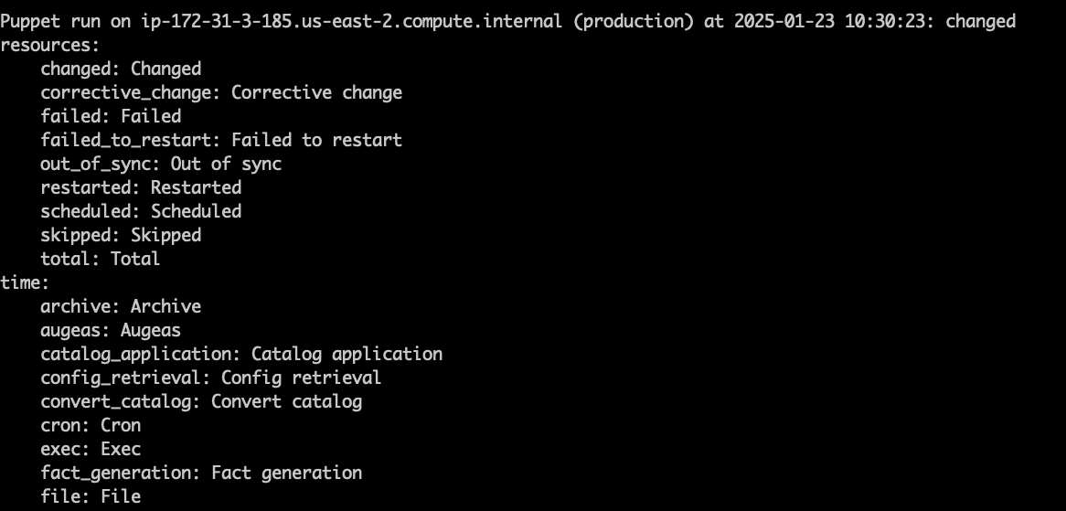
Running the Report Processor

Slide 17
What's Next?

