Slide 1

Can You Help Me Upgrade to Puppet 8?
David Swan
Principal Software Engineer
February 2025 | #ConfigMgmtCamp Ghent

Slide 2

What Should Be Done First?
Update your Hiera
  Ensure that the version is set to at least 5.
Correct your Puppet version
  Ensure that you are bringing in the newest Puppet version.
Check that your dependencies allow Puppet 8
  Ensure that each module dependency that you have brought in has completed the above steps.
And now, let's do that…
Notes:
- With the release of Puppet 8, the minimum version of Hiera has been raised to 5
- To use Puppet 8 you must first set the dependency in your module to allow it
- Finally, take a look at whatever modules may be listed as dependencies and make sure that they are Puppet 8 compatible

Slide 3

Now Let’s Do That…

Slide 4



Legacy Facts
  Now it’s time to start the more complex changes:
  With Puppet 8, support for the legacy style facts has been removed
  This means that going forward, all references to the legacy style must be replaced with their modern alternatives
    Both in the Puppet code
    And in the Ruby code
Notes:
Add example pictures

Slide 5

Example Time!

Slide 6
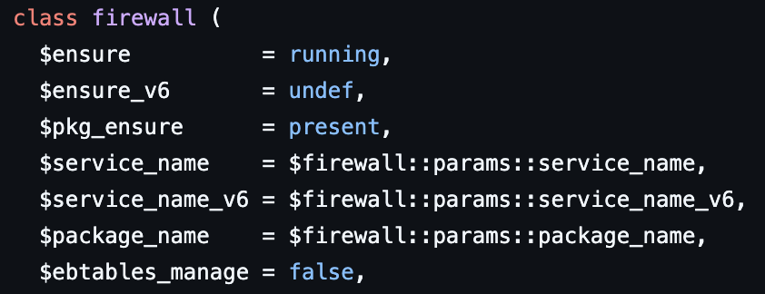
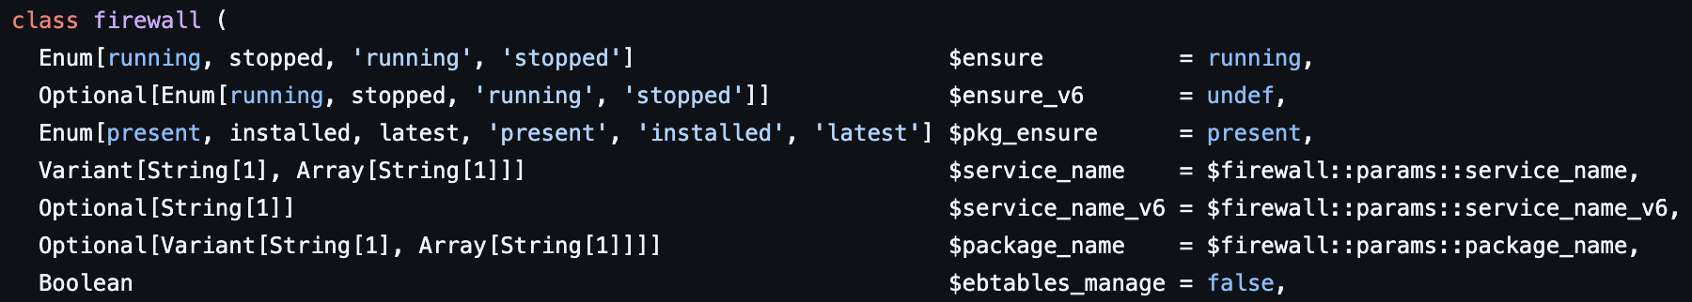
Missing Datatypes
  One important change, that I hope none of you need to do, is to ensure that all parameters within your module have a datatype.
  This has always been the advised behaviour, but is now required
    The module will now fail to run and error out, if a datatype is missing
Notes:
One important change, that I hope none of you need to do, is to ensure that all parameters within your module have a datatype.
While this has always been advised behaviour, the changes made with Puppet 8 mean it is now required and if it is not done the code will fail to compile and error out.

Slide 7

One More Time ☺
I swear, I am not trying to drag this out to fill time

Slide 8
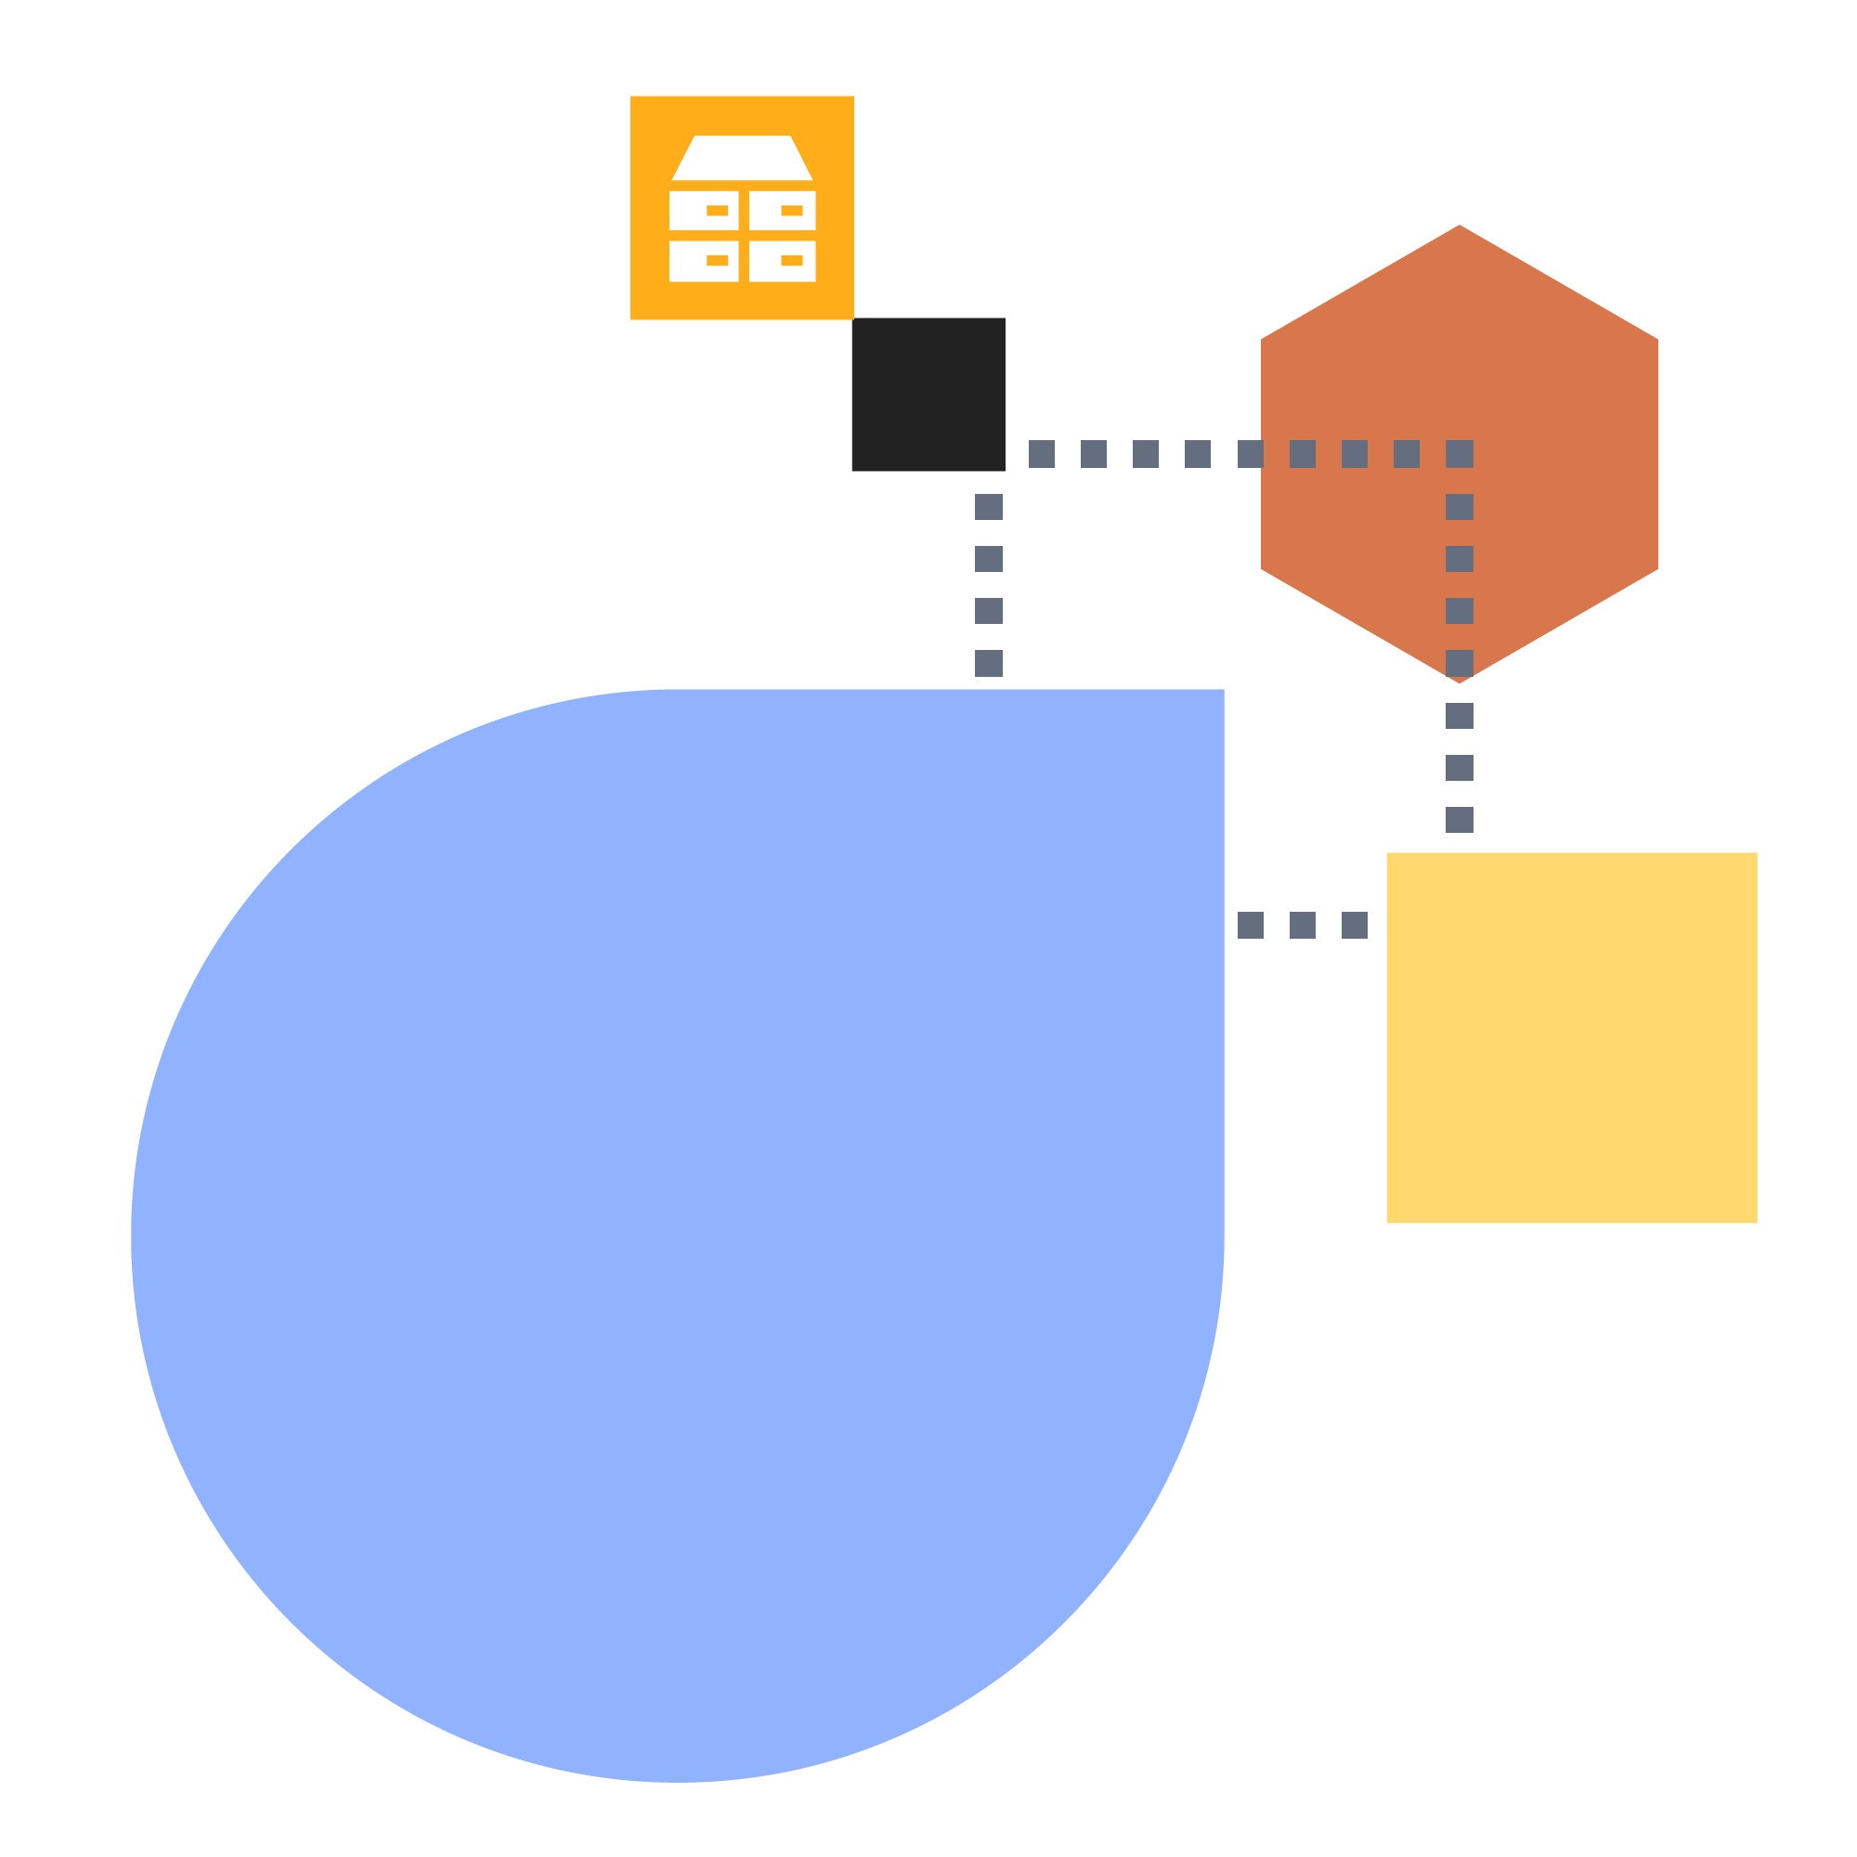

Other Smaller Changes
  Ensure that Puppet 4 functions are given the stdlib namespace where applicable
  Remove any top-scope facts or variables, keep them within the local definition
  PSON is no longer supported, use JSON instead
  Strict mode is now default, any code that caused warnings will now fail

Slide 9


Moving Forward
  One thing you may notice about these changes is that before they were mandatory. They were all considered best practice for a considerable period.
  So, expecting that this may occur again in the future, here is a link to the official style guide that lays out the current best practices and which will be kept updated in the future.
https://www.puppet.com/docs/puppet/8/style_guide.html

Slide 10


Some Useful Links
  Verifying code and modules are compatible with Puppet 8: https://github.com/puppetlabs/puppet/wiki/Puppet-8-Compatibility#module-compatibility
  Using Onceover to test for Puppet 8 readiness:
  https://dev.to/puppet/puppet-8-readiness-with-onceover-135f
  A list of deprecated puppetlabs-stdlib functions: https://puppetlabs.github.io/content-and-tooling-team/blog/posts/2023-05-12-deprecation-of-stdlib-functions/
  Contacting Puppet Professional Services for upgrade help: https://www.puppet.com/professional-services

Slide 11


Thank You for Listening!
https://dev.to/puppet/updating-modules-to-puppet-8-58h3

