Slide 1
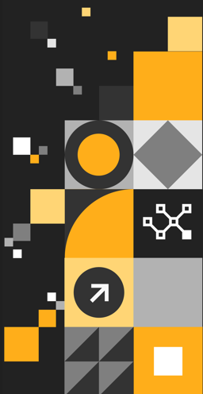
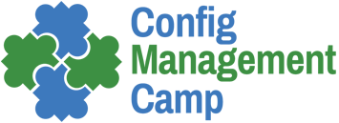
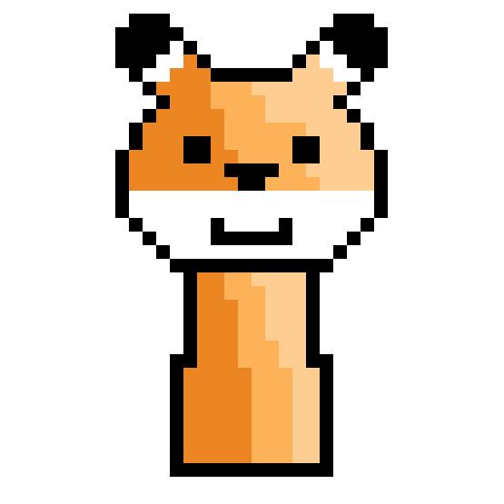
Puppet Community Plan
David Sandilands
Community and Developer Relations Lead | Puppet by Perforce
February 2025 | #ConfigMgmtCamp Ghent

Slide 2

“There have been times, lately, when I dearly wished that I could change the past. Well, I can’t, but I can change the present, so that when it becomes the past, it will turn out to be a past worth having.”
”
― Terry Pratchett, "I Shall Wear Midnight"
Notes:
A glimpse of tomorrow:
Environments will be more distributed and heterogeneous with high-velocity changes—and the more material exposure to cyber-security risks, and the regulations and compliance that go along with that.
There will not be enough people to do the manual work required to operate environments at this scale; nor would it be advisable from a security standpoint. Automation is no longer a nice-to-have; it is a fundamental requirement for enterprise companies
Do you want to leave your security up to manual processes that could create mistakes?
With security becoming everyone's job how do you maintain the same standards for quality/implementation/urgency ... wouldn't you rather automate?
Application Developers will not independently rule the world. They will partner with a new type of operator (an infrastructure developer, a cloud engineer ) who is building out and running intelligent, proactive, and self-healing systems that allow their organizations to focus on delivering differentiation. In fact, the new operator will be a progressive blend of developer-minded admin plus system-thinking developers.
In tomorrow’s self-healing environments, the workflows and actions—from initial provisioning to running at scale, to seamless decommissioning—will be automatic. And enforcing security and ensuring compliance will be inherent
The CIO role did not die when SaaS and Public Cloud became mainstream—rather, it changed. Similarly, the operator role is not going to die with cloud native. It will change, too. Just like leading CIOs of today are a blend of the progressive business-minded CIOs combined with a dose of technology-savvy business leaders, the operators of the future will be a blend of the progessive development-minded operators combined with operations-minded developers who understand the power and importance of next-gen technology environments, and are attracted to solving the complexities and cyber security risks they present.
Another parallel is what is happening in the network world … network admins are no longer going to be managing boxes as the world moves to software defined networks - they will transform into network developers / software defined network operators - some coming from the traditional network admin world and others from the more traditional software development world. Similarly infrastructure operators will no longer be managing servers and VMs - they will be managing containers and workflows. Some coming from the DevOps world and others from the more traditional software development world.

Slide 3
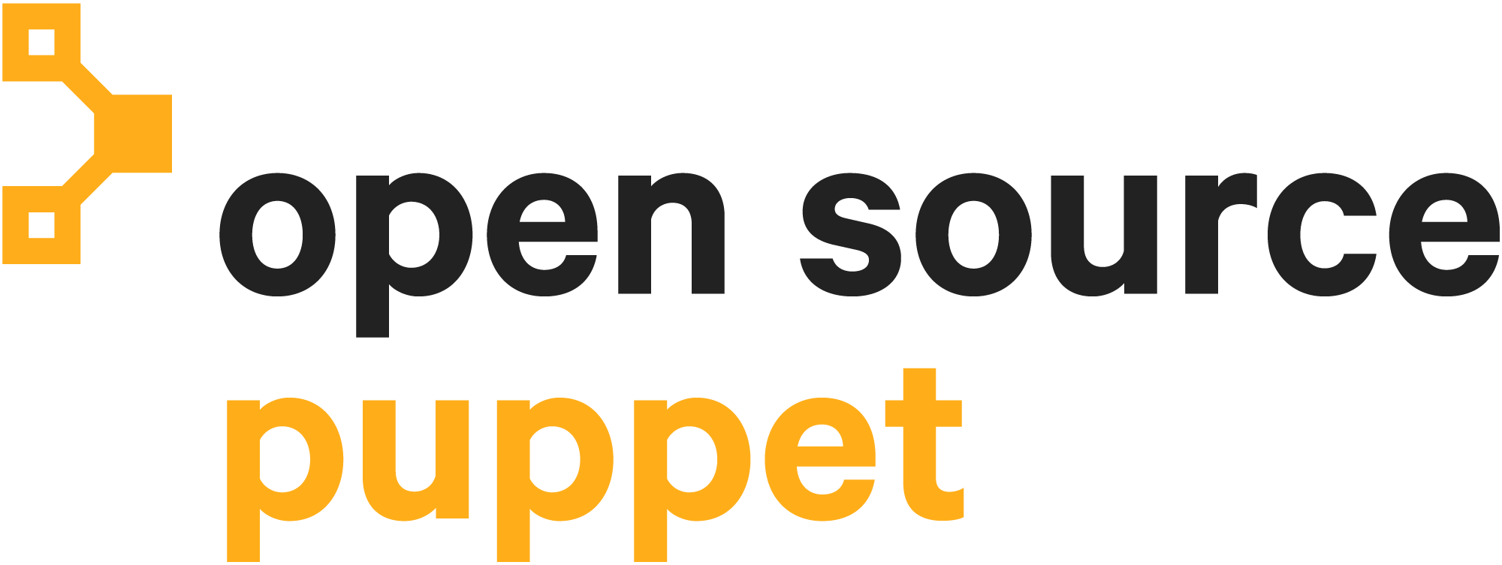
The Changes and What They Mean
Current binaries will remain in place
The source code in public repos will remain under Apache
Critical CVEs (9+) will be fixed
Public pull request process to support community users
Puppet 9.x working with standards steering group to partner with users and community
Notes:
So to give a high level
PE - A
PE
CORE
OPENVOX
Public repos?
How many repos changed how many products affected

Slide 4
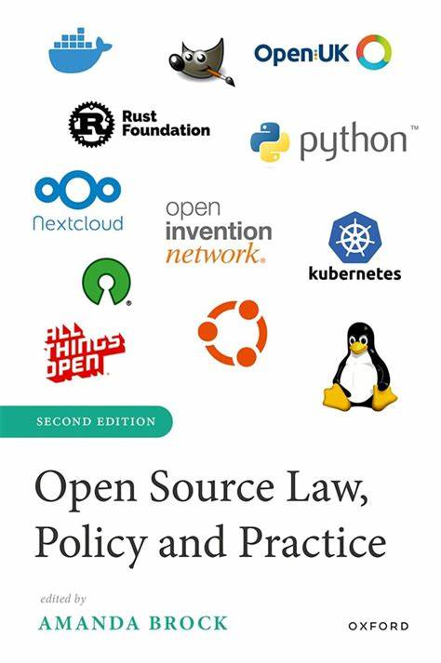
I Bet You Didn't Go Into This to Learn Trademark Law
Why a fork?
Community needed the autonomy without Perforce top-level ownership
Perforce could not legally give rights to a community group to use its trademarks without any control
We were able to confirm the rights to use functional code CLI/libraries under ASL

Slide 5

“You can't go around building a better world for people. Only people can build a better world for people.
Otherwise, it's just a cage.”
”
― Terry Pratchett, "Witches Abroad"
Notes:
A glimpse of tomorrow:
Environments will be more distributed and heterogeneous with high-velocity changes—and the more material exposure to cyber-security risks, and the regulations and compliance that go along with that.
There will not be enough people to do the manual work required to operate environments at this scale; nor would it be advisable from a security standpoint. Automation is no longer a nice-to-have; it is a fundamental requirement for enterprise companies
Do you want to leave your security up to manual processes that could create mistakes?
With security becoming everyone's job how do you maintain the same standards for quality/implementation/urgency ... wouldn't you rather automate?
Application Developers will not independently rule the world. They will partner with a new type of operator (an infrastructure developer, a cloud engineer ) who is building out and running intelligent, proactive, and self-healing systems that allow their organizations to focus on delivering differentiation. In fact, the new operator will be a progressive blend of developer-minded admin plus system-thinking developers.
In tomorrow’s self-healing environments, the workflows and actions—from initial provisioning to running at scale, to seamless decommissioning—will be automatic. And enforcing security and ensuring compliance will be inherent
The CIO role did not die when SaaS and Public Cloud became mainstream—rather, it changed. Similarly, the operator role is not going to die with cloud native. It will change, too. Just like leading CIOs of today are a blend of the progressive business-minded CIOs combined with a dose of technology-savvy business leaders, the operators of the future will be a blend of the progessive development-minded operators combined with operations-minded developers who understand the power and importance of next-gen technology environments, and are attracted to solving the complexities and cyber security risks they present.
Another parallel is what is happening in the network world … network admins are no longer going to be managing boxes as the world moves to software defined networks - they will transform into network developers / software defined network operators - some coming from the traditional network admin world and others from the more traditional software development world. Similarly infrastructure operators will no longer be managing servers and VMs - they will be managing containers and workflows. Some coming from the DevOps world and others from the more traditional software development world.

Slide 6
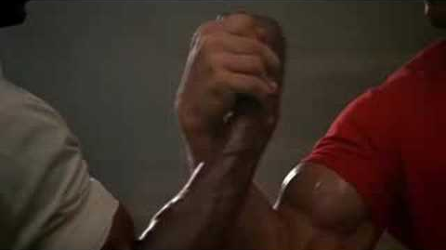
How We're Moving from a Dependency to a Partnership
Standards steering group
New trusted contributors
Clear internal structures on how to contribute code
EULA Developer access with access 6 weekly build
Notes:
Add example pictures

Slide 7
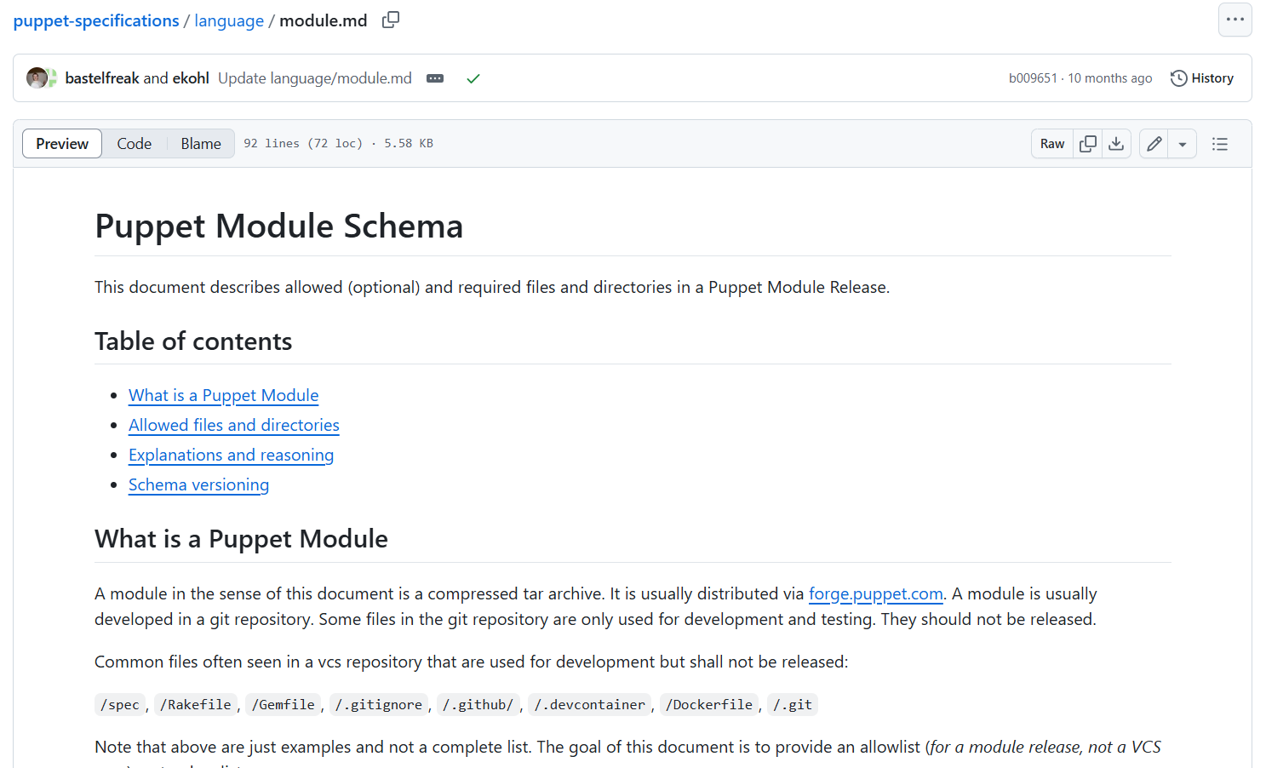
The Standards Steering Group
The standards steering group will be held in an open/transparent fashion with active participation from Perforce and community leadership
Suggested setup
          - An OpenVox representative
          - A Perforce representative
          - A user group representative

Slide 8
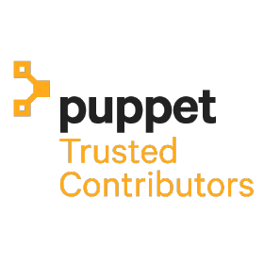
The Trusted Contributor Group
Establish clear standards of who can join the trusted contributors
Create a process with a clear trackable SLA of when people can be onboarded.
Transparent and clear process of when inactive or no longer meeting standards users are at risk of removal

Slide 9
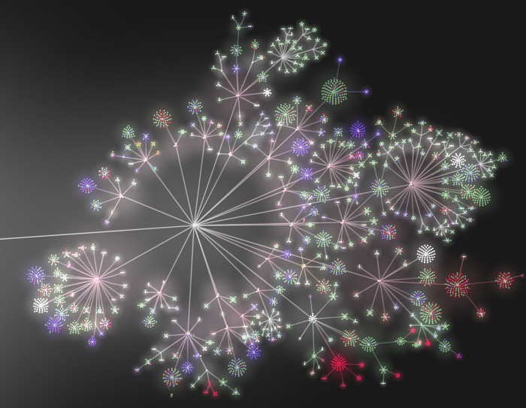
Code Project Ownership and Maintenance
Our code projects are currently unclear to our community. Going forward, we'll provide:
Clear indications of ownership
Maintenance/lifecycle schedules
Regular triage and review of PRs and issues (if project is marked as 'accepting contributions')
Notes:
Add example pictures

Slide 10
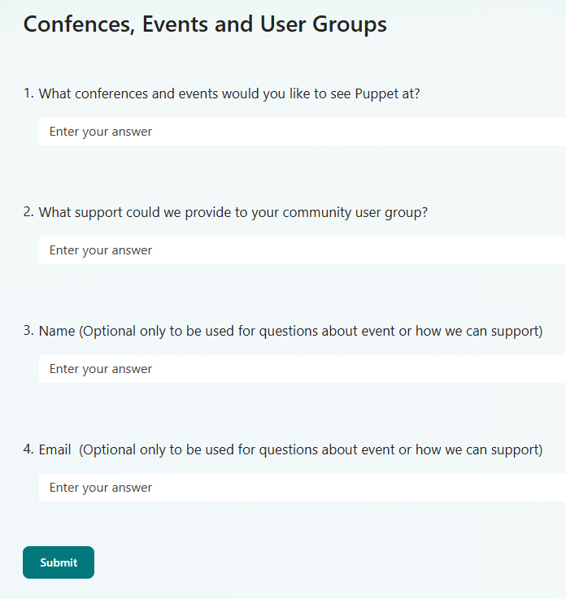
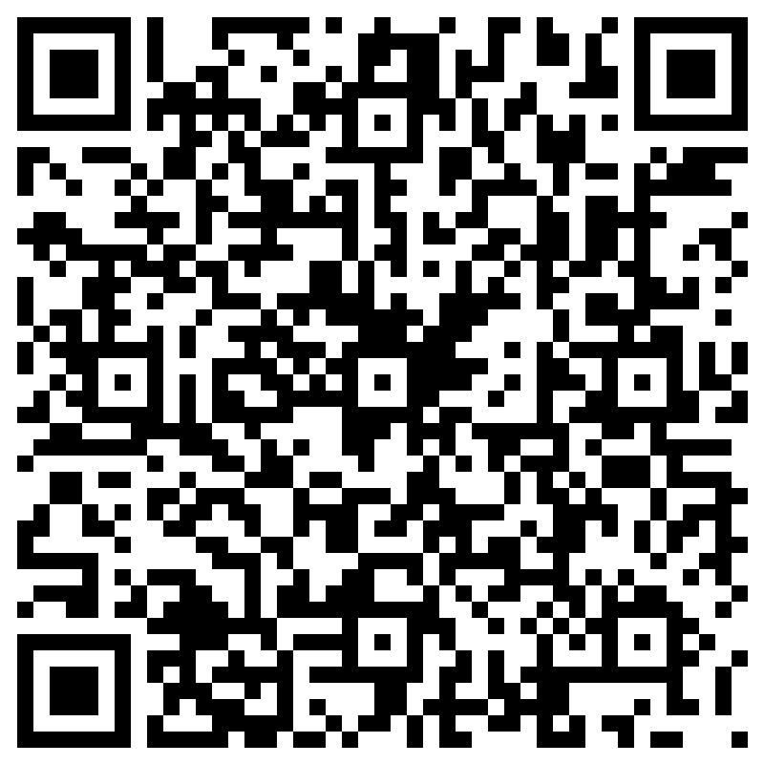
Community Events
Vendor-specific events are vanishingly rare
People are not reliably in office/expecting to be late home
We want to know from you what events are most useful and how can we support community user groups
We'll communicate event schedules in advance to allow customers and community to plan ahead
Notes:
Make sure this is an ask, where, when, can we help your community chapter, attend with SEs

Slide 11
Timeline
Work together to evolve the community
Q1
Q2
Q3
Q4
Confirm Alignment &
Standards Steering Group Processes
Begin Call for Puppet
Community Co-Op Events & Calendar
Regroup with
Steering Committee
Revisit Education
& Advocates
Program

Slide 12

“Saruman believes it is only great power that can hold evil in check, but that is not what I have found.
I found it is the small everyday deeds of ordinary folk that keep the darkness at bay. Small acts of kindness and love.”
”
― Gandalf the Grey, "The Hobbit"
Notes:
The last few years has seen far too much energy across our industry wasted with fights between community and tech firms
Companies have matured and must make a sustainable business but there is no reason to leave community behind to do this. Moving from Steward to partner reflects the changes and allows the best for all

Slide 13
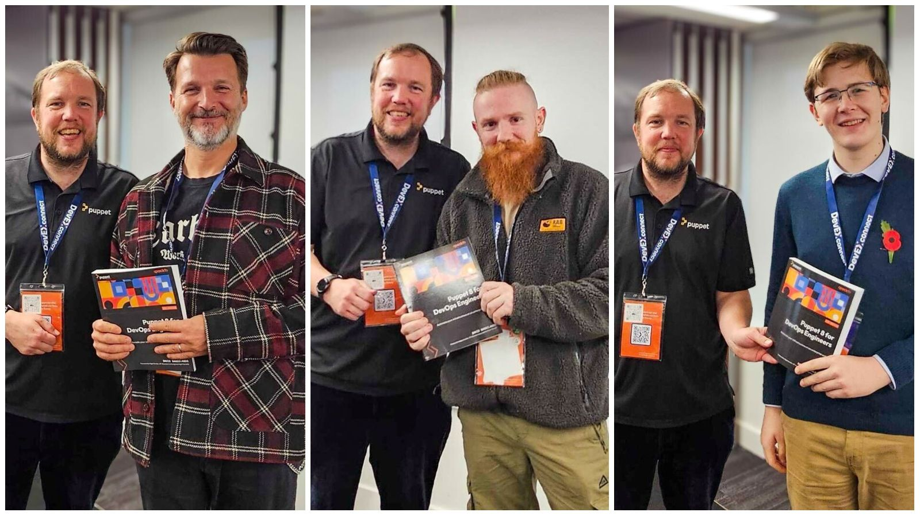
Takeaways
  Move to a partnership with unanimous decisions
  Reform our code maintenance
  Plan collaborative events with the community

Slide 14
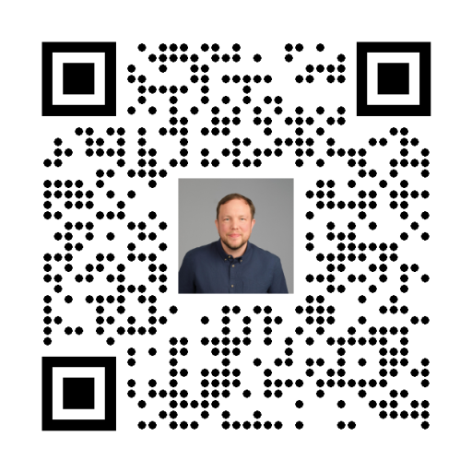
Q&A
Notes:
As I mentioned earlier, one of the patterns we see often is one or two teams see initial success, that success is recognized by management and then there’s a desire to replicate that success more broadly across more teams. In order to continuing the momentum and scale that success, teams have to develop the ability to share, which is one of the four pillars of DevOps according to the CAMS model.
This is why all of our foundations practices are so dependent on sharing and promote sharing.

