Slide 1
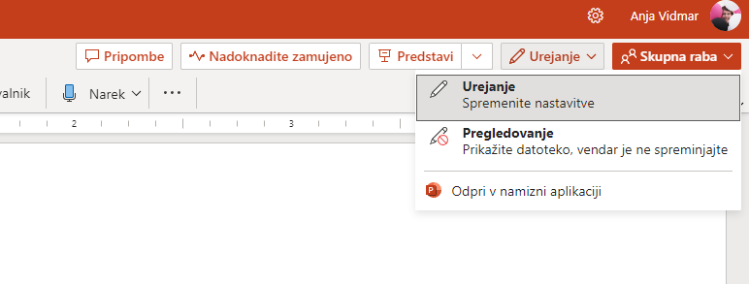
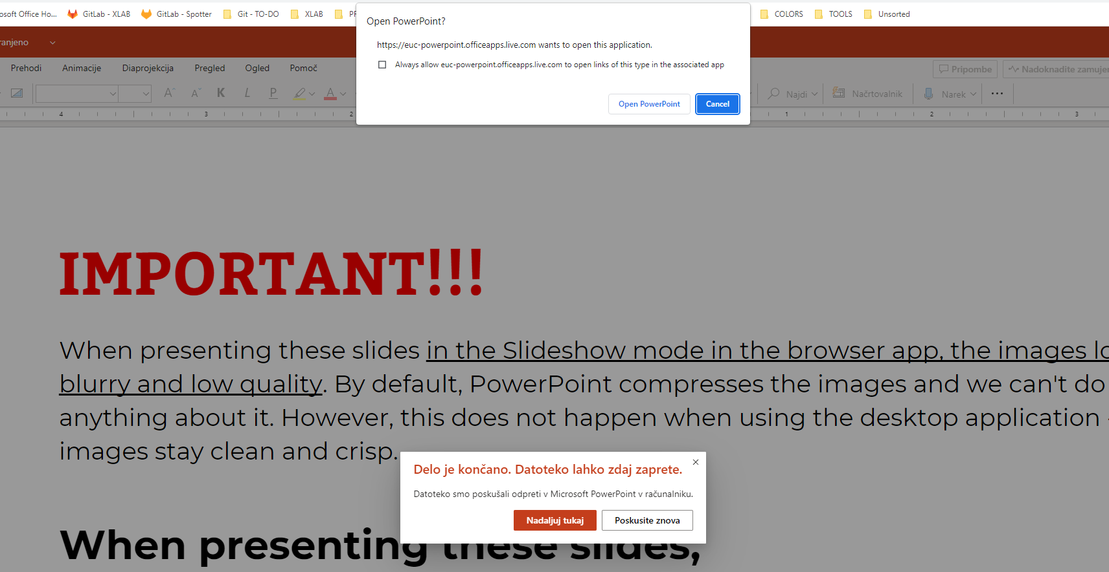
IMPORTANT!!!
When presenting these slides in the Slideshow mode in the browser app, the images look blurry and low quality. By default, PowerPoint compresses the images and we can't do anything about it. However, this doesn’t happen when using the desktop application - images stay clean and crisp.
When presenting these slides,
please use the desktop application!

Slide 2

Debugging Playbooks Made Easy: The Ansible Playbook Debugger
February 2, 2026
Jure Medvešek
Senior Ansible Expert and Lead Developer at XLAB Steampunk

Slide 3
Agenda
1.
Motivation
Examples
What the Spotter Ansible Playbook Debugger is
What the Spotter Ansible Playbook Debugger is not
Implementation details
Live Demo
2.
3.
4.
5.
6.

Slide 4
Motivation
Writing playbooks from scratch can be hard
Known obstacles:
What a result from previous task was
How to map/filter data in correct format to use in next task
...
Solution in other programing languages:
Use debugger, and inspect the values
Notes:
Ask audience for thers ideas, then represent our known options

Slide 5
Ansible playbook debugging
How can one overcome this issues?
Any ideas?
Notes:
Ask audience for thers ideas, then represent our known options

Slide 6
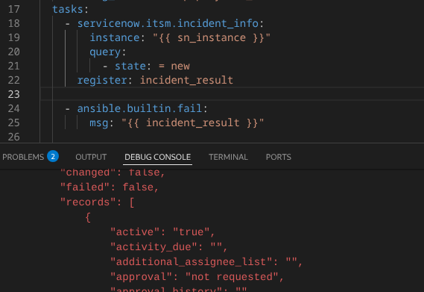
Known options
Printf debugging
Verbose mode
  Output and continue
ansible.builtin.debug
  Output and continue
ansible.builtin.fail
  Output and break

Slide 7
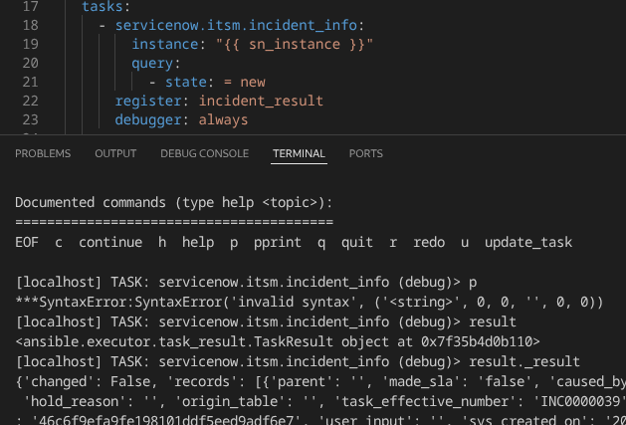
Known options
Debugger keyword
As task argument
inside Ansible

Slide 8
Known options
Stdout callback plugin
  One can write own callback plugin and output data to stdout or file
  Many already exist
  Lots of event where one can hook to

Slide 9
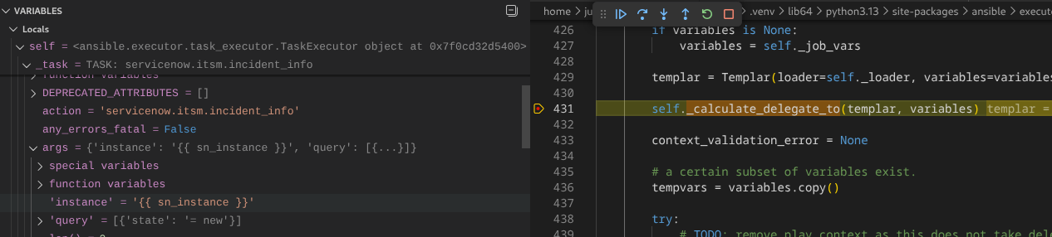
Known options
Abuse Python debugger
  One can set breakpoints on correct place inside ansible-core or any other collection python code
  Same idea was crucial for implementation of Steampunk Ansible Playbook Debugger that is being presented today

Slide 10
Known options
IDE debugger - VSCODE:
this implementation
jborean93/ansibug
  As a disclaimer since it is alternative implementation which started before ours

Slide 11
What the Spotter Ansible Playbook Debugger is
Playbook, roles and tasks debugger
It inspects the flow of Ansible over YAML files

Slide 12
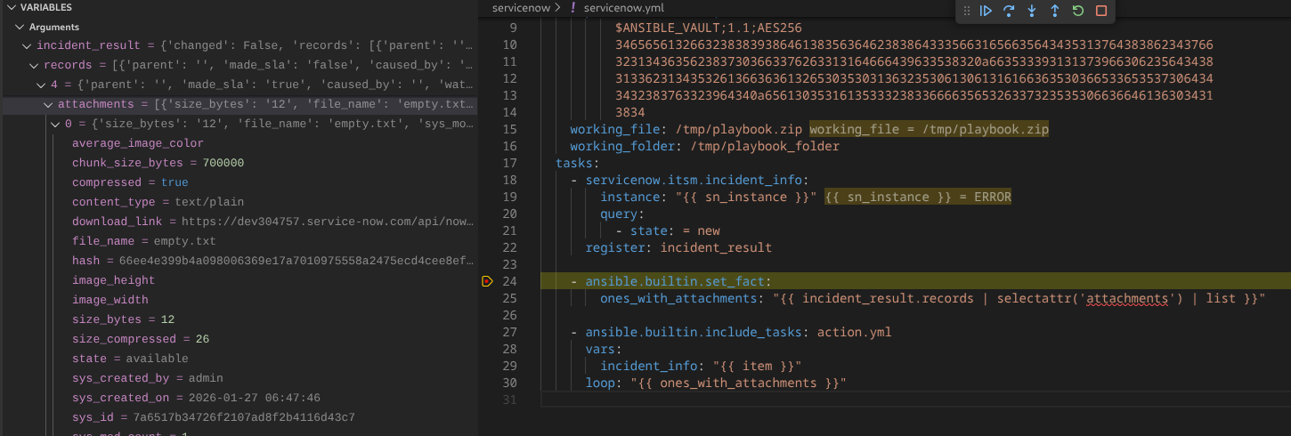
Identified use cases
Retrieving task result structure
Notes:
Structure of incident_info result is complex and deeply nested. Tree visualization of result helps a lot.

Slide 13
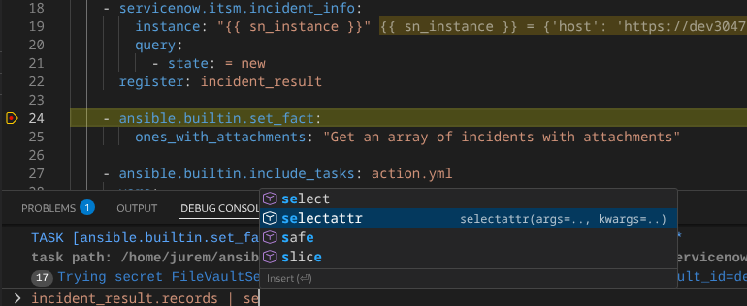
Identified use cases
Evaluating Jinja expressions
On real variables and facts at runtime

Slide 14
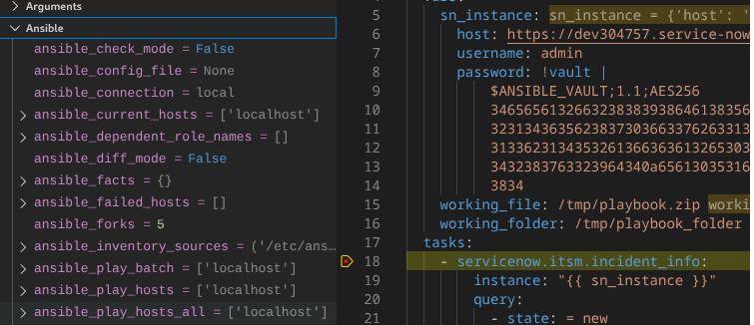
Identified use cases
Listing Ansible facts

Slide 15
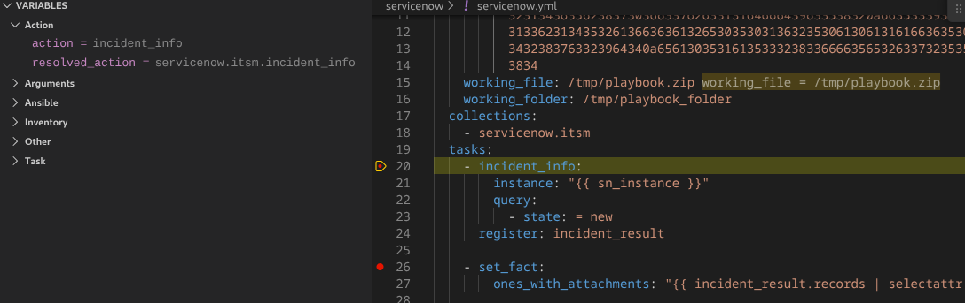
Identified use cases
FQCN name

Slide 16
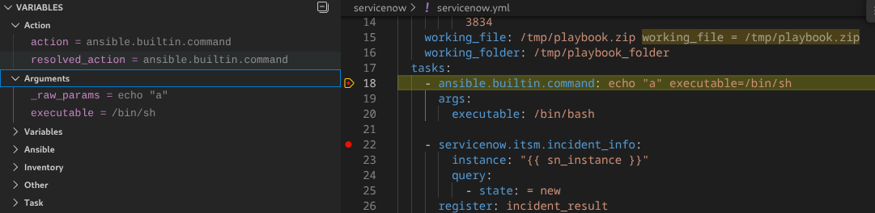
Identified use cases
Precedence of arguments evaluation

Slide 17
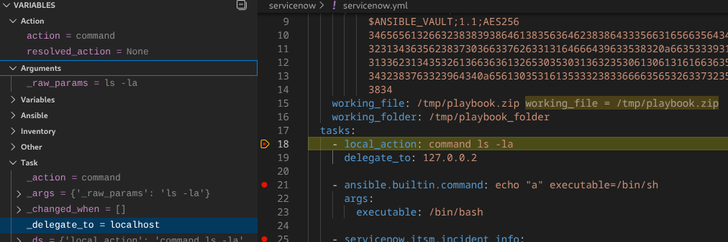
Identified use cases
Precedence of delegate to over local action

Slide 18
Identified use cases
Executing up to exact point
No data dumps in logs
No code changes after done
Notes:
- not true with debug, fail, debugger keyword

Slide 19
Specifications
Architecture
Control flow
Functionalities
...

Slide 20
Architecture
VSCode plugin using DAP protocol
Easier than expected
Protocol itself guides implementation
Single Python file without external libraries
About 1000 lines of code

Slide 21
Supported Ansible versions
Ansible code is stable
From ansible-core 2.11 to 2.18 - it can run in any thread
From ansible-core 2.19 - it must run main thread

Slide 22
Supported python and OS
Tested using CPython on Linux and MacOS
On Mac virtual environment may be needed

Slide 23
Control flow that debugger supports
Breakpoint
Stop on start
Step
Continue
To allow to stop on custom task.
Granularity – per task
It is called even before gather facts is executed on playbook.
Execute till next task.
Execute till next breakpoint or till the end of a playbook.
Notes:
Step is more or less step into – currently do not support jump over include/import

Slide 24
Additional choices
Stop once per task, or for every iteration inside loop
Not obvious – we added a debugType attribute
once per task definition (strategy)
once per loop item (action)
In both cases we stop before when task is executed, so one can check to what it evaluates.

Slide 25
Spotter Ansible Playbook Debugger
Features
Inspection of the state before the task execution
  Facts
  Vars
  Task arguments
Dynamic evaluation of expressions

Slide 26
Functionalities that debugger support
Watch / Debug console
Due to technical limitations supported only in debugType strategy
In current implementation this is most powerful tool, since it supports dynamic evaluation

Slide 27
What the Spotter Ansible Playbook Debugger is not
Debugger for Ansible plugin of any type
Functionality is mostly covered by python debugger already

Slide 28
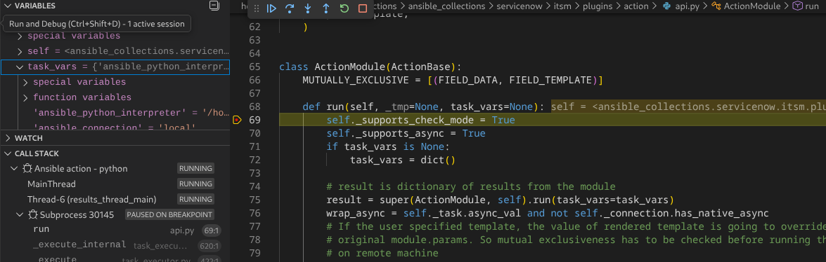
What the Spotter Ansible Playbook Debugger is not
Action plugin debugger – use python debugger

Slide 29
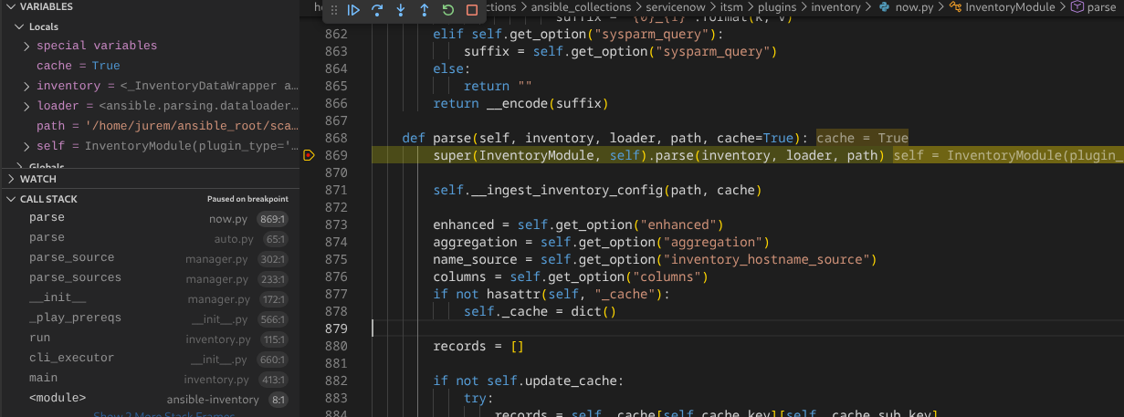
What the Spotter Ansible Playbook Debugger is not
Inventory plugin debugger – use python debugger

Slide 30
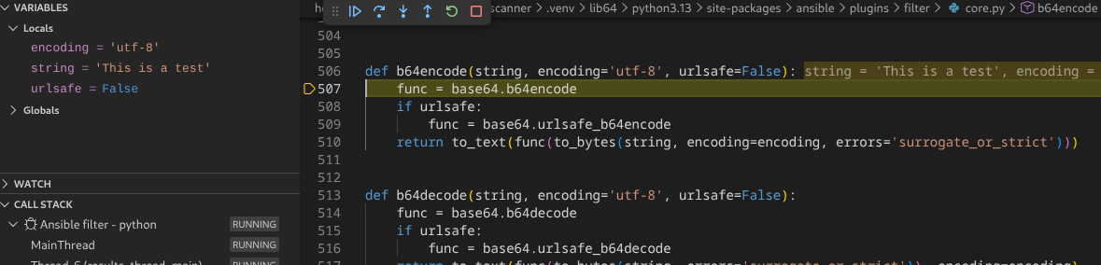
What the Spotter Ansible Playbook Debugger is not
Filter, test or lookup plugin debugger – use python debugger

Slide 31
What the Spotter Ansible Playbook Debugger is not
Debugger for any other Ansible plugin type
Module, strategy, …

Slide 32
Who is affected by that
Authors of collections
As a coauthor of servicenow.itsm collection in the past, I can tell that python debugging of Ansible modules code would make life a lot easier.
Large enterprises
Our experience is that paying AAP customers need to write own plugins.
Them being authors of collections – just private ones.

Slide 33
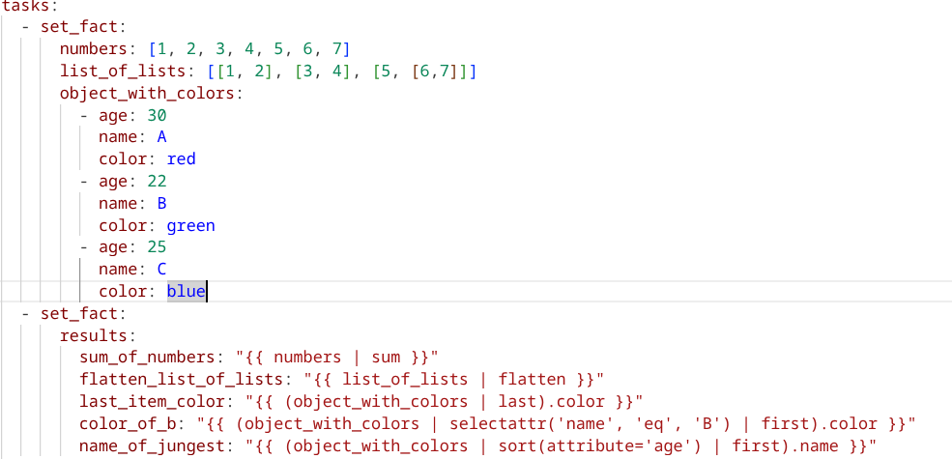
Artificial examples of usage - LIVE DEMO

Slide 34
Real world example (service now) - LIVE DEMO

Slide 35
Security considerations
Masking secrets
Debugger have access to ALL variables – even those in vault
Why it is not that problematic
No privilege escalation – need to know ansible-vault password
Consequence if it is
Root of the problem is ansible-core
2.19 seems to hide secrets better than 2.18 or earlier

Slide 36
Overriding variable values – not implemented
Variable protection
Cloned before used in any plugin
This is correct way
Overriding values - options
Override in task context
Override in global context
Override in both contexts

Slide 37

Q&A
Ask me anything

Slide 38






Thank you!
Get in touch
Find out more
Follow us
jure.medvesek@xlab.si
steampunk@xlab.si
steampunk.si/spotter/

