Slide 1
Writing, running and testing Ansible content with Natural language and AI - powered by Ansible Devtools MCP Server
Shatakshi Mishra
Software Engineer, Ansible Devtools
GitHub: shatakshiiii
Matrix: @shatakshiiii:matrix.org

Slide 2
Agenda
A look at the problem: The hidden cost of context switching in Ansible Content Development
Tooling Overview of VSCode extension MCP server
Demo time
Summary
Call to action

Slide 3
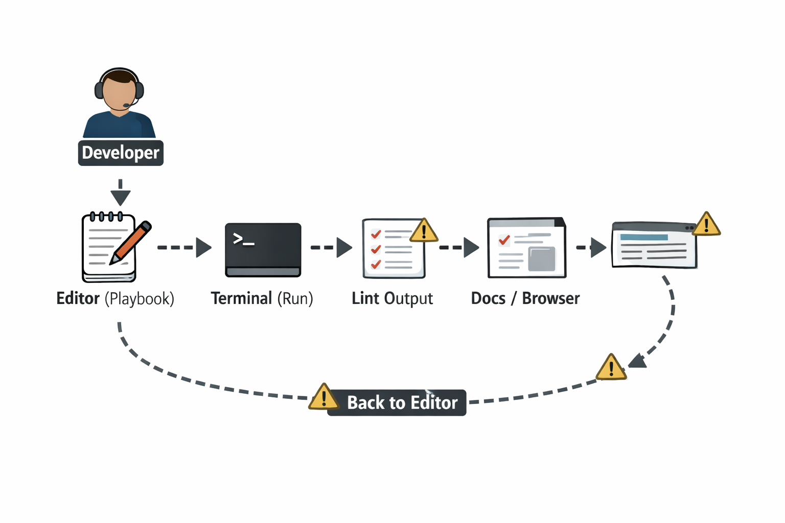
The hidden cost of context switching
Mental context rebuilt again and again across tools
Editor → terminal → browser → docs → back to editor
Lint, run, and debug workflows that don’t talk to each other
Environment-specific failures discovered too late
Information lost between authoring, validation and execution.

Slide 4
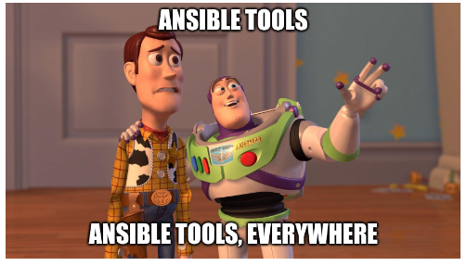
Fragmented development experience

Slide 5
A closer look into the problem
Every tool is correct on its own — but none of them share what they already know
Example -
Lint, run and debug workflows that don’t talk to each other
ansible-lint reports issues without runtime context
ansible-playbook failures lack awareness of lint and static analysis results
ansible-navigator debugging starts without the authoring and validation context
Developers manually correlate:
lint findings → playbook lines → execution failures

Slide 6
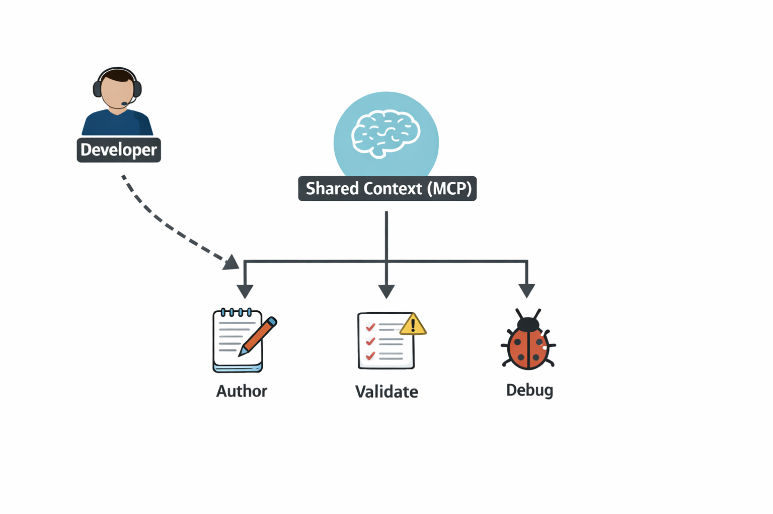
What if context wasn’t lost?
Model Context Protocol (MCP) Server
Enables AI models to interact with external tools through a unified interface
Enables multiple Ansible developer tools to operate on the same shared context
VSCode enables us to create servers that provides tools, prompts, and resources for extending the capabilities of AI agents in VS Code

Slide 7
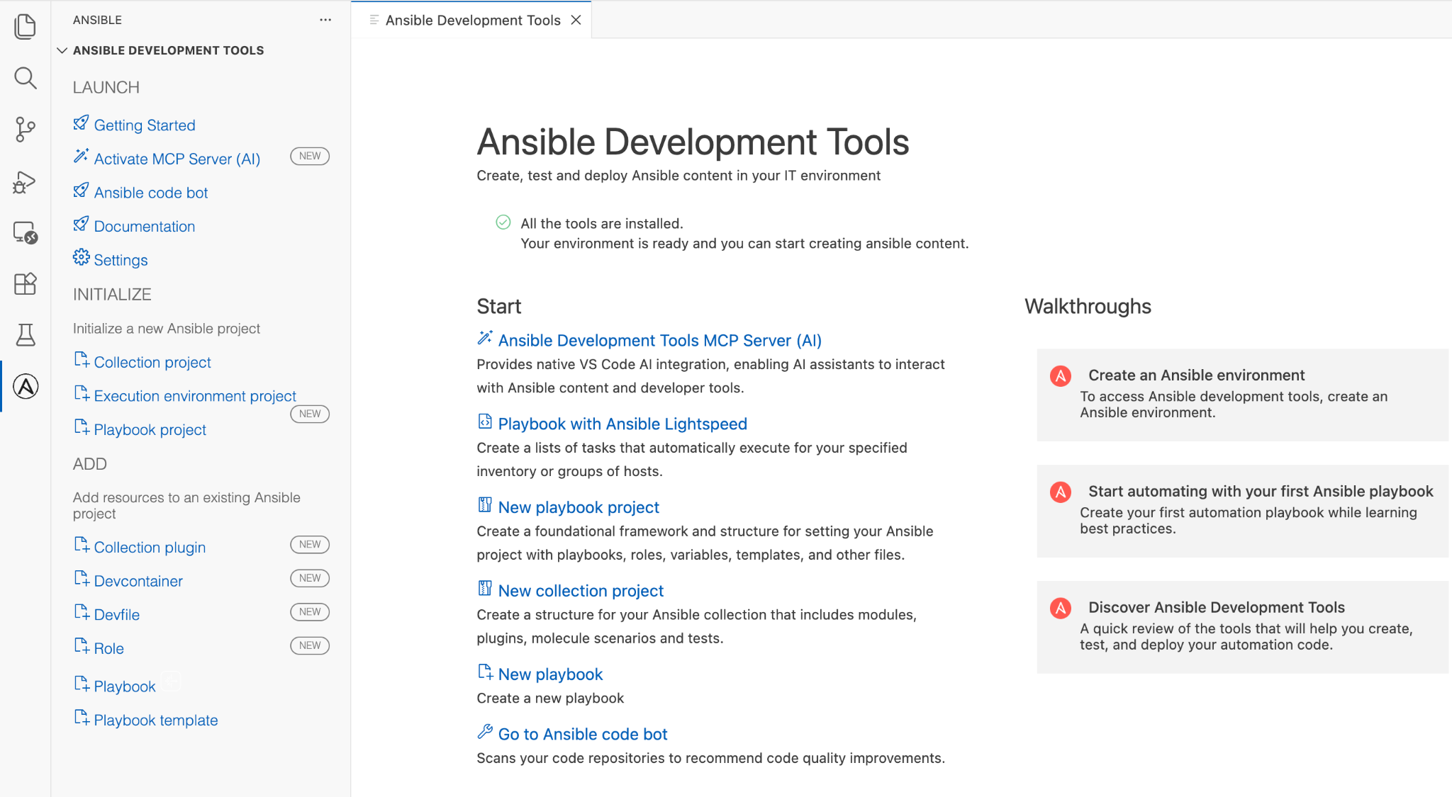
VSCode extension (Graphical UI to Ansible Development Tools )

Slide 8
VSCode extension (Graphical UI to Ansible Development Tools )
Visual Studio Code extension for Ansible development.
Syntax highlighting, linting, intelligent code completion.
Extensive configuration options.
Supports containerized execution environments.
Guides and webviews for ADT (ansible-dev-tools) features.

Slide 9
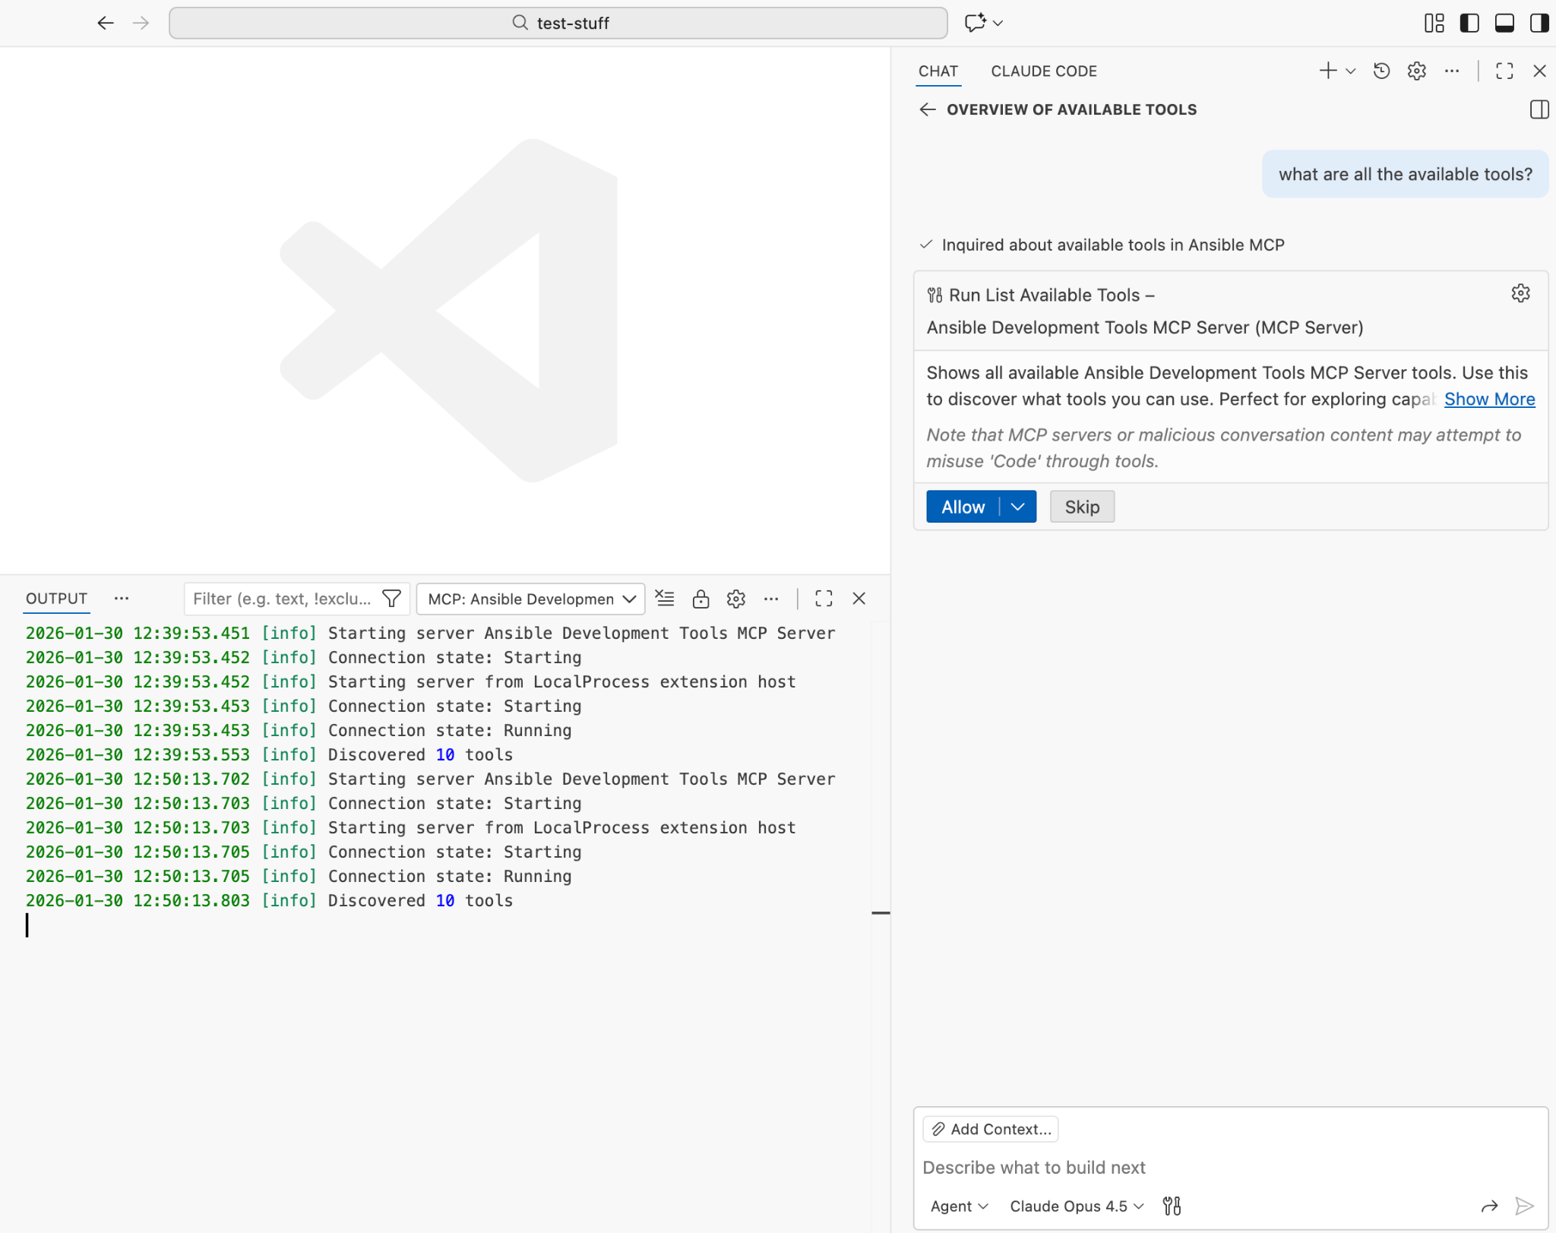
MCP-server with built in ADT support
Curated, all-in-one Ansible developer toolkit
Streamlined developer workflow with support for creating, testing and debugging automation
“Native” vscode experience that minimizing command-line use and help new users to understand the workflow

Slide 10

Enabling the MCP Server
Option1 - Using VS Code Command Palette
Press Ctrl+Shift+P (or Cmd+Shift+P on macOS) and search for "Ansible: Enable Ansible Development Tools MCP Server"
Find and select “MCP: List Servers” in the command palette. Select “Ansible Development Tools MCP Server” to start the server.

Slide 11
Enabling the MCP Server
Option 2 - Using Ansible Extension Settings
In the Settings window, select Extensions > Ansible > MCP Server.
Click the checkbox next to Enable the Ansible Development Tools MCP server
Find and select “MCP: List Servers” in the command palette. Select Ansible Development Tools MCP Server to start the server.

Slide 12
Enabling the MCP Server
Option 3 - Using Getting Started Guide
In the Ansible Extension Sidebar, click on Getting Started followed by Ansible Development Tools MCP Server (AI)
Find and select “MCP: List Servers” in the command palette. Select Ansible Development Tools MCP Server to start the server.

Slide 13
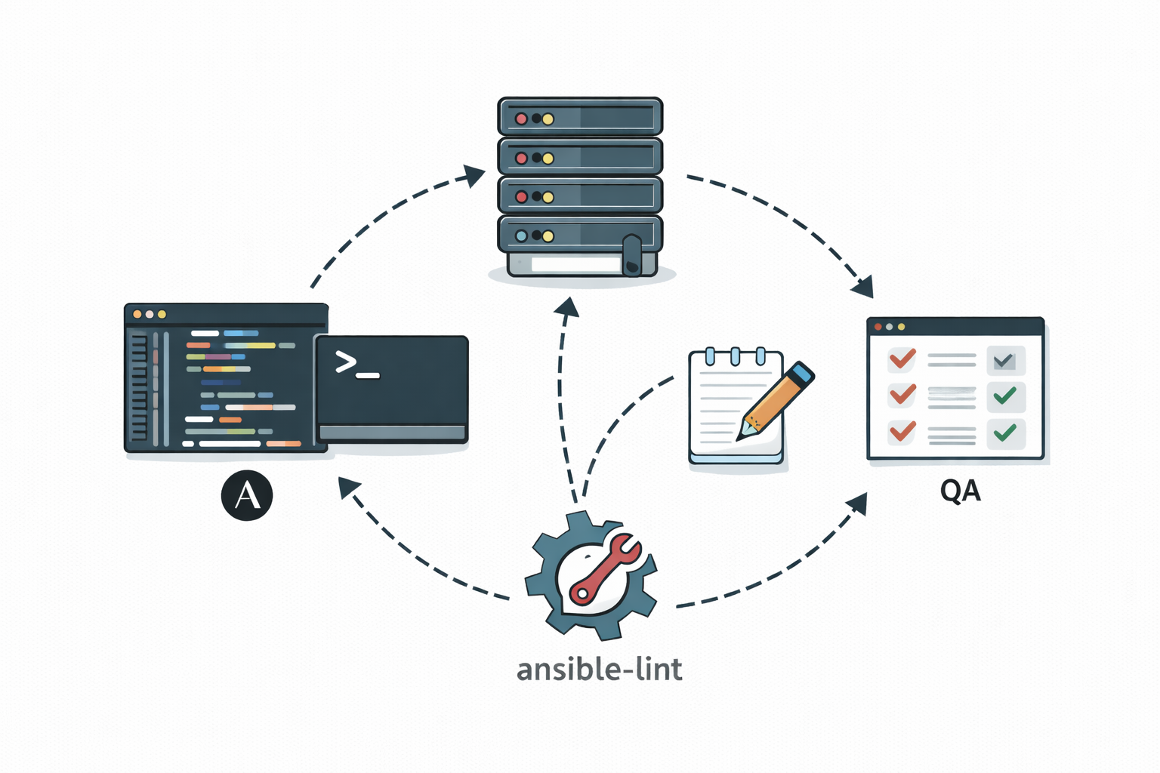
Closer look at the tools and entire workflow

Slide 14
Setting up your virtual environment
ade_environment_info
Provides comprehensive environment diagnostics:
Python version and path
Ansible version
Installed ansible collections
ade_setup_env
Sets up a complete Ansible development environment with:
Virtual environment creation
Python packages installation
Ansible collection installation
OS-aware package manager detection

Slide 15
List available tools and get information about ansible-dev-tools
list_available_tools
Displays the entire list of tools available with their short summary.
adt_check_env
Checks if ansible-dev-tools (ADT) is installed and installs it if missing. ADT includes all the developer goodies in a single python package.

Slide 16
Create a new playbook project
create_ansible_projects
Scaffolds new Ansible projects using ansible-creator:
Collection project: Full collection structure as per the FQCN namespace and collection name.
Playbook project: Scaffolds ansible best practices directory structure with inventory, roles, playbooks and other configuration files.

Slide 17
Review ansible best practices
ansible_content_best_practices
Provides best practices and guidelines for Ansible content. Topics include:
YAML formatting
Naming conventions
Role structure
Playbook design
Variables and Jinja2 Template
Inventory management
Call with a specific topic (e.g. “roles”, “playbooks”) or without arguments to see all available topics.

Slide 18
Lint playbook and Define execution environment for your playbook
ansible_lint
Runs ansible-lint on your playbooks to detect issues. Supports --fix for auto-remediation of certain issues.
define_and_build_execution_env
Creates execution environment (EE) definition files for ansible-builder:
Specify base image, Python packages, system packages
Include Ansible collections
Generate validated execution-environment.yml files
Used to build custom container images for running Ansible in isolated environments.

Slide 19
Run playbook in your custom EE using ansible-navigator
ansible_navigator
Runs playbooks using ansible-navigator with smart features.
Finds playbook file from natural language request
Uses a container runtime (podman or docker, whichever it finds first)
Automatically disables EE if Podman/Docker fails

Slide 20

Demo Time

Slide 21
Demo Time

Slide 22
Demo Time

Slide 23
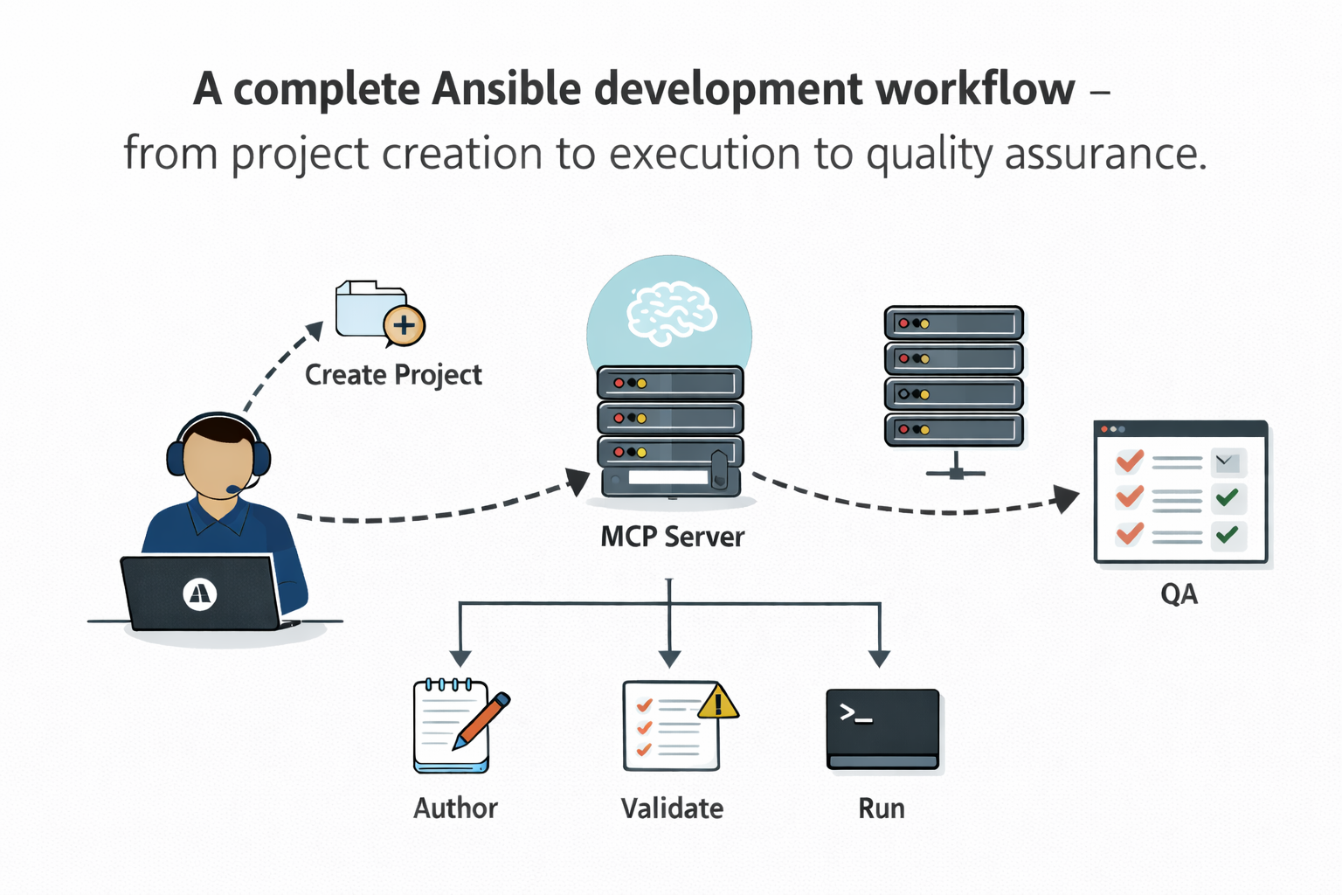
Summary

Slide 24

We want to hear from you!
Focus areas in the year ahead:
More improvements in MCP server tooling integration
Providing consistent developer experience
Forum post: Ansible DevTools plans and collaboration opportunities
Let us know what you think:
What enhancements or new features do you want to see?
What do you think works well currently?
What are your biggest pain points?

Slide 25

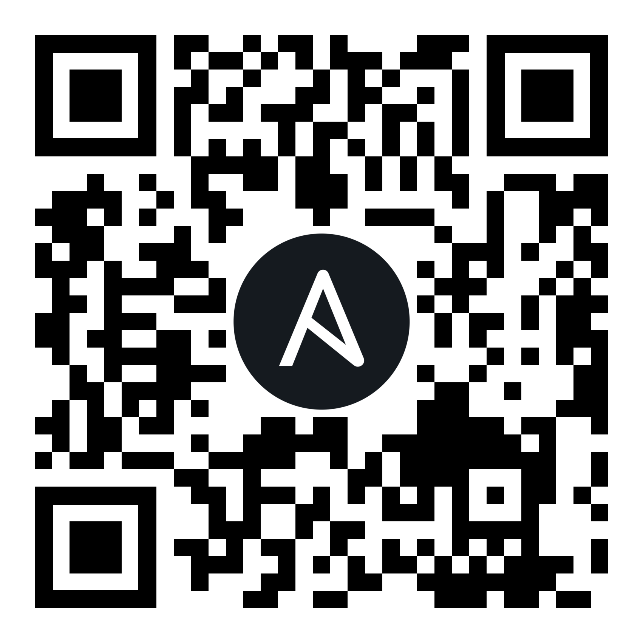
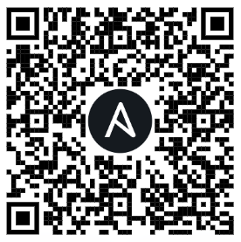
Ansible community
Join the forum to participate in discussions and get help!
Want to contribute? Find out how to get involved.
Notes:
Forum: The Ansible Forum is the default place for Ansible communities to chat, share, learn, help each other, and discuss projects. You’re welcome to join the conversation. The forum lets you filter topics with categories and labels: so you can subscribe only to things that interest you. (Invite people at the booth to talk in-person if relevant)
Contributing: Interested in helping the Ansible project? There are many ways how can do it! Check out the How Can I Help? page. (Invite people at the booth to talk in-person if relevant)
If you are interested in contributing to Ansible and helping our open-source project thrive, there are lots of opportunities for folks with many different skills and interests! Check out the How Can I Help? page. (Invite people at the booth to talk in-person if relevant)

Slide 26
Thanks!
Matrix: #community:ansible.com #social:ansible.com
Ansible community forum:
https://forum.ansible.com/

